Slide 1
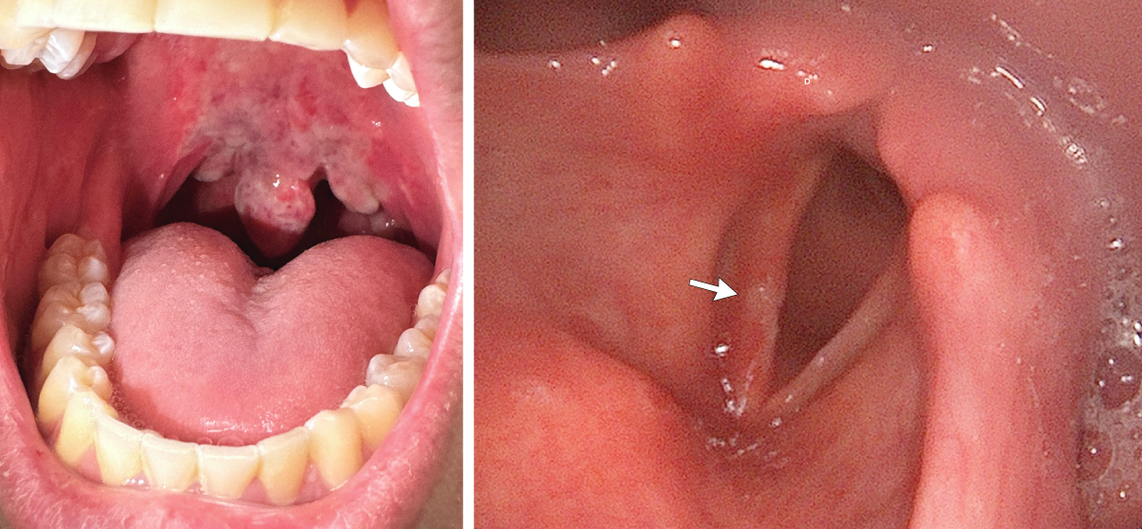
Image Challenge
Q:
A 23-year-old man presented to an outpatient health center with a 2-day history of painful swallowing and hoarseness. The symptoms developed after he had inhaled nitrous oxide through his mouth from a hand-held canister for recreation. Physical examination was notable for erythema, swelling, and sloughing of the mucosa on the soft palate, uvula, and posterior oropharynx. There was no increased work of breathing or stridor. Flexible nasolaryngoscopy revealed a small area of ulceration and swelling on the right vocal fold. What is the most likely diagnosis?
1. Chemical mucositis
2. Frostbite injury
3. Hypersensitivity reaction
4. Oropharyngeal candidiasis
5. Thermal injury

Slide 2
Image Challenge
Q:
A 23-year-old man presented to an outpatient health center with a 2-day history of painful swallowing and hoarseness. The symptoms developed after he had inhaled nitrous oxide through his mouth from a hand-held canister for recreation. Physical examination was notable for erythema, swelling, and sloughing of the mucosa on the soft palate, uvula, and posterior oropharynx. There was no increased work of breathing or stridor. Flexible nasolaryngoscopy revealed a small area of ulceration and swelling on the right vocal fold. What is the most likely diagnosis?
Answer:
Frostbite injury
A diagnosis of frostbite injury from inhaled nitrous oxide use was made. Nitrous oxide gas, which is known as “whippets” or “laughing gas” when inhaled recreationally, is stored as a liquid in pressurized canisters. Both the gas and the canister rapidly become cold on release of the gas and may result in contact frostbite injuries.

