Slide 1
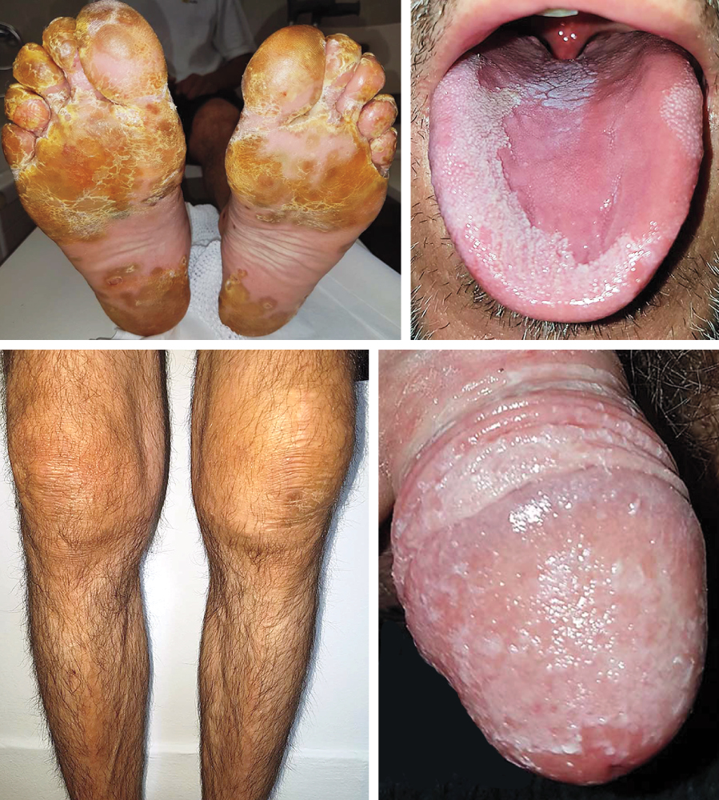
Image Challenge
Q:
A 40-year-old man presented with a 2-week history of scaly foot rash, joint swelling, penile rash, knee swelling, tongue changes, red eyes, and low back pain. He had had diarrhea and urethral discharge 7 days before the onset of symptoms. On examination, yellow pustules with hyperkeratosis were seen on his plantar feet. What is the name of this physical examination sign?
1. Keratoderma blenorrhagicum
2. Palmoplantar keratoderma
3. Pitted keratolysis
4. Porokeratosis
5. Pustular psoriasis

Slide 2
Image Challenge
Q:
A 40-year-old man presented with a 2-week history of scaly foot rash, joint swelling, penile rash, knee swelling, tongue changes, red eyes, and low back pain. He had had diarrhea and urethral discharge 7 days before the onset of symptoms. On examination, yellow pustules with hyperkeratosis were seen on his plantar feet. What is the name of this physical examination sign?
Answer:
Keratoderma blenorrhagicum
The correct answer is keratoderma blenorrhagicum. The C-reactive protein was elevated, urinalysis showed sterile pyuria, and tests for infectious agents and rheumatoid factor were negative. Analysis of left knee synovial fluid was consistent with noninfectious inflammatory arthritis. A diagnosis of reactive arthritis was made. The patient was treated with nonsteroid anti-inflammatory agents, systemic glucocorticoids, and sulfasalazine.

