Slide 1
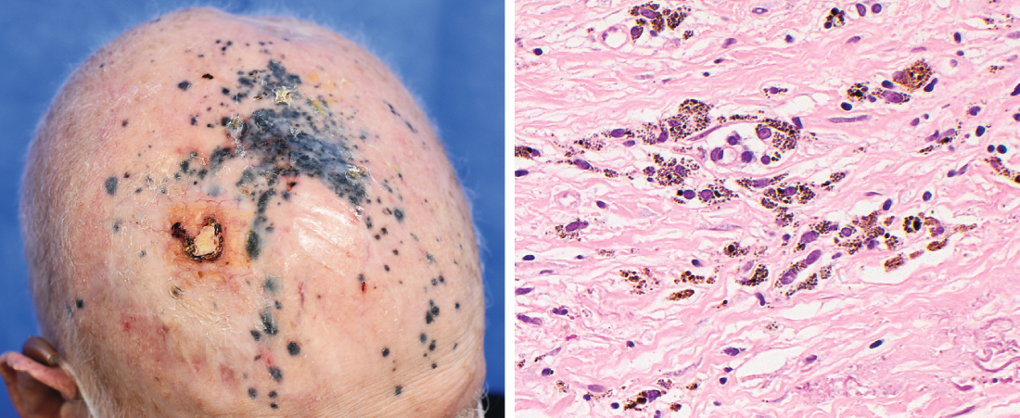
Image Challenge
Q:
An 84-year-old man with a history of melanoma of the right forehead complicated by in-transit metastases to the scalp presented to the dermatology clinic. Seven months prior, treatment with two immunotherapy agents had been started, which had resulted in shrinking of the metastatic scalp nodules. On physical examination, there were multiple blue-gray macules on the scalp, as well as an unhealed ulcer from trauma. Dermoscopy-guided biopsy of four macules revealed scattered melanin-laden macrophages within the superficial and middle dermis without any evidence of residual melanoma. Immunohistochemical staining of a biopsy sample for markers of melanoma was also negative. What is the most likely diagnosis?
1. Lentigo maligna
2. Metastatic melanoma
3. Post inflammatory hyperpigmentation
4. Solar lentigo
5. Tumoral melanosis

Slide 2
Image Challenge
Q:
An 84-year-old man with a history of melanoma of the right forehead complicated by in-transit metastases to the scalp presented to the dermatology clinic. Seven months prior, treatment with two immunotherapy agents had been started, which had resulted in shrinking of the metastatic scalp nodules. On physical examination, there were multiple blue-gray macules on the scalp, as well as an unhealed ulcer from trauma. Dermoscopy-guided biopsy of four macules revealed scattered melanin-laden macrophages within the superficial and middle dermis without any evidence of residual melanoma. Immunohistochemical staining of a biopsy sample for markers of melanoma was also negative. What is the most likely diagnosis?
Answer:
Tumoral melanosis
Tumoral melanosis is a pigmented skin lesion that results when melanin released from melanoma cells is taken up by dermal macrophages. It can be seen after regression of melanoma, sometimes as a response to immunotherapy. Absence of nodularity is supportive of tumoral melanosis; however, histologic assessment is needed to differentiate melanoma metastases from tumoral melanosis.

