Slide 1
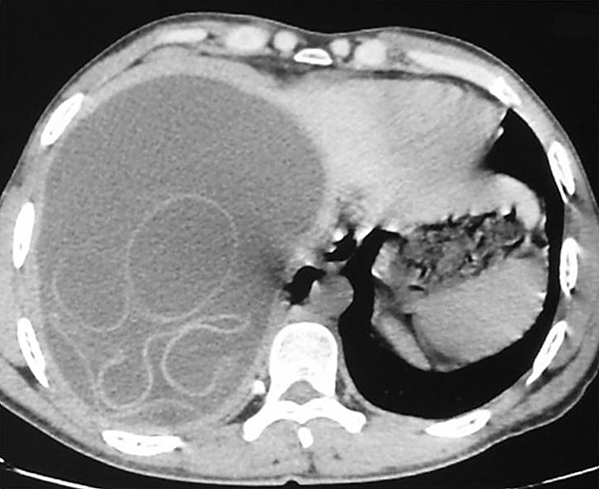
Image Challenge
Q:
A 30-year-old man presented with a 15-month history of intermittent discomfort in the right upper quadrant of the abdomen. He lived in a rural area of Morocco and had occasional contact with dogs. The physical examination revealed hepatomegaly with a palpable hepatic mass. Laboratory tests showed a normal white-cell count and a normal absolute eosinophil count. Ultrasonography and computed tomography of the abdomen revealed a large cyst in the right lobe of the liver. What is the diagnosis?
1. Primary hepatic carcinoma
2. Autoimmune hepatitis
3. Primary biliary cholangitis
4. Amebiasis
5. Cystic echinococcosis

Slide 2
Image Challenge
Q:
A 30-year-old man presented with a 15-month history of intermittent discomfort in the right upper quadrant of the abdomen. He lived in a rural area of Morocco and had occasional contact with dogs. The physical examination revealed hepatomegaly with a palpable hepatic mass. Laboratory tests showed a normal white-cell count and a normal absolute eosinophil count. Ultrasonography and computed tomography of the abdomen revealed a large cyst in the right lobe of the liver. What is the diagnosis?
Answer:
Cystic echinococcosis
The correct answer is cystic echinococcosis. Dogs are the definitive host for the Echinococcus granulosus tapeworm. The infection is transmitted when eggs shed in their stool are ingested by humans or other animals.

