Slide 1
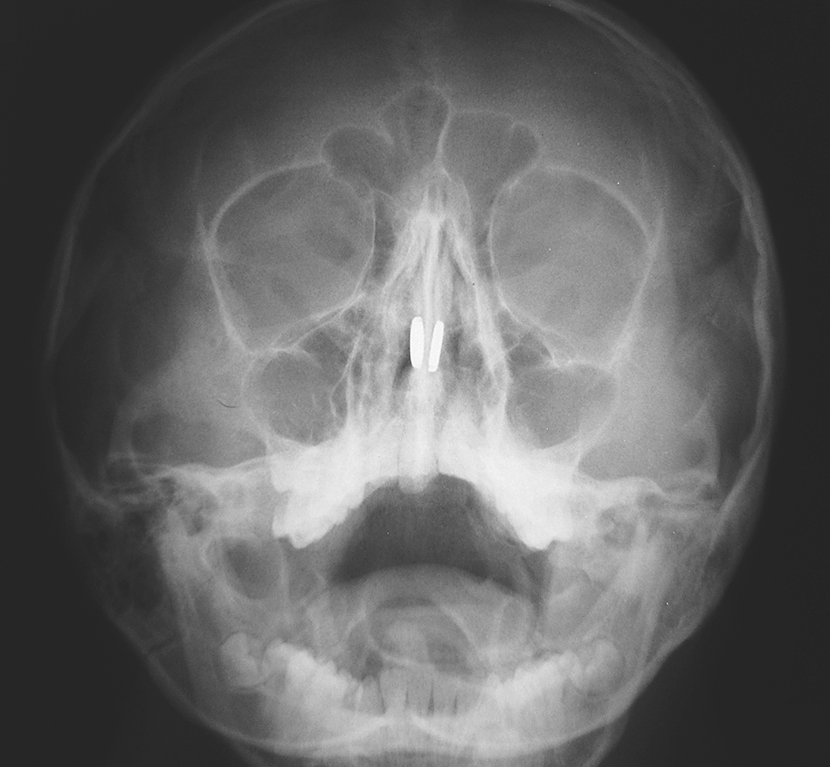
Image Challenge
Q:
An 11-year-old boy was brought to the emergency department with epistaxis and severe nasal pain. What is the likely diagnosis?
1. Nasal polyps
2. Nasal septum fracture
3. Pills in the nasal cavity
4. Coins in the nasal cavity
5. Button magnets in the nasal cavity

Slide 2
Image Challenge
Q:
An 11-year-old boy was brought to the emergency department with epistaxis and severe nasal pain. What is the likely diagnosis?
Answer:
Button magnets in the nasal cavity
The correct answer is button magnets in the nasal cavity. Children commonly insert objects into body cavities. The discovery of attracting magnets in the nasal cavity necessitates emergency removal because they can compress the mucosa of the nasal septum, leading to necrosis and septal perforation.

