Slide 1
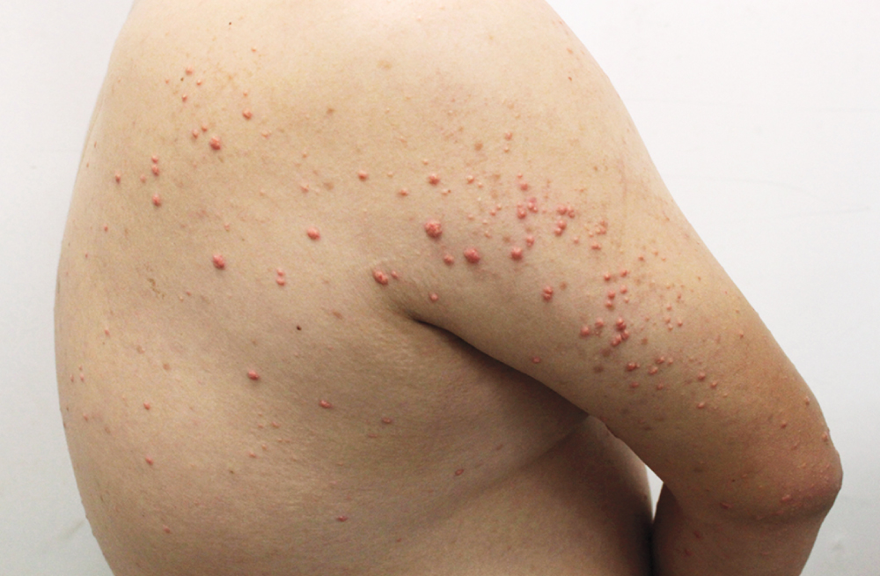
Image Challenge
Q:
A 27-year-old man with a history of obesity presented to the dermatology clinic with an asymptomatic rash on his back, arms, and hands that had developed 1 week earlier. On physical examination, scattered pink-yellow papules were present on the upper back, extensor surfaces of the upper arms, and dorsa of the hands. A fasting blood sample was grossly lipemic. Which of the following is the most likely diagnosis?
1. Eruptive xanthomas
2. Generalized eruptive histiocytoma
3. Granuloma annulare
4. Molluscum contagiosum
5. Sebaceous hyperplasia

Slide 2
Image Challenge
Q:
A 27-year-old man with a history of obesity presented to the dermatology clinic with an asymptomatic rash on his back, arms, and hands that had developed 1 week earlier. On physical examination, scattered pink-yellow papules were present on the upper back, extensor surfaces of the upper arms, and dorsa of the hands. A fasting blood sample was grossly lipemic. Which of the following is the most likely diagnosis?
Answer:
Eruptive xanthomas
A diagnosis of eruptive xanthomas due to severe hypertriglyceridemia was made. Eruptive xanthomas should be suspected in patients with risk factors suggestive of dyslipidemias. The skin lesions abated after treatment with fenofibrate, alcohol cessation, exercise, and a low-fat diet.

