Slide 1
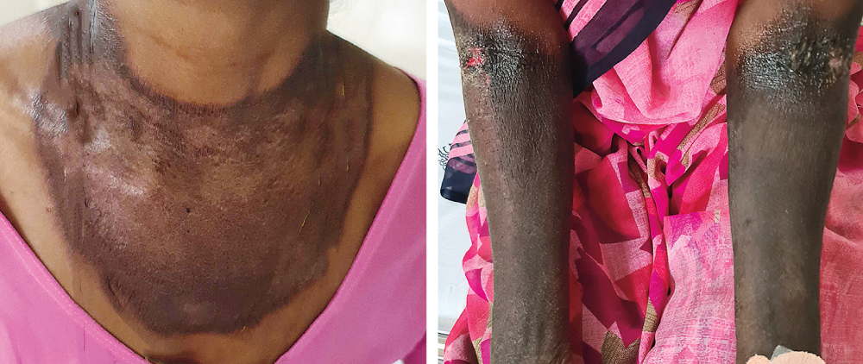
Image Challenge
Q:
A 48-year-old woman who lived in rural India presented with diarrhea, weight loss, and a rash. Physical examination showed well-demarcated areas of hyperpigmentation on the sun-exposed areas of her neck, chest, and forearms. What is the most likely diagnosis?
1. Cobalamin (vitamin B12) deficiency
2. Pellagra
3. Phytophotodermatitis
4. Porphyria cutanea tarda
5. Zinc deficiency

Slide 2
Image Challenge
Q:
A 48-year-old woman who lived in rural India presented with diarrhea, weight loss, and a rash. Physical examination showed well-demarcated areas of hyperpigmentation on the sun-exposed areas of her neck, chest, and forearms. What is the most likely diagnosis?
Answer:
Pellagra
A diagnosis of pellagra, or niacin deficiency, was made on the basis of the patient’s diarrhea and symmetric, photosensitive dermatitis, including a typical Casal’s necklace rash. After the patient was treated with vitamin B complex supplementation, the diarrhea resolved and the skin hyperpigmentation was reduced.

