Slide 1
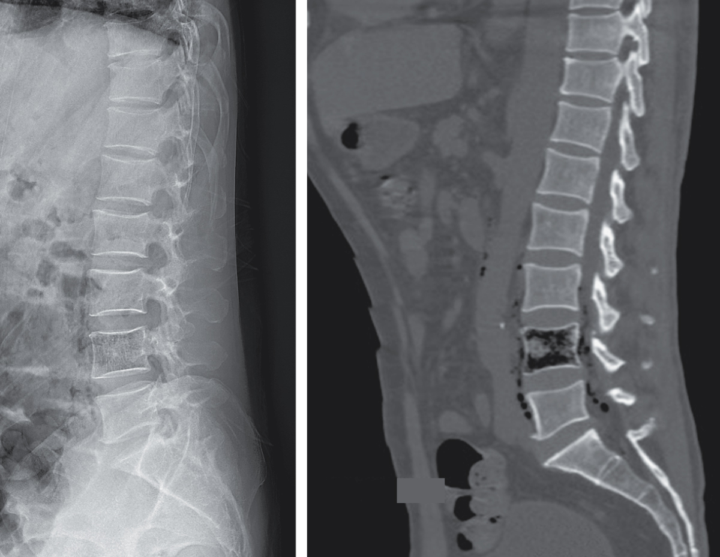
Image Challenge
Q:
A 62-year-old man presented with a 5-day history of low back pain and a 1-day history of lethargy. Physical examination was notable for tenderness over the lumbar spine and a normal neurologic examination. Radiographs of the lumbar spine showed gas within L4. Computed tomography of the lumbar spine confirmed the presence of intramedullary gas within L4, and also showed that the gas extended into the surrounding soft tissue, epidural space, and psoas muscles. What is the most likely etiology of this skeletal finding?
1. Air embolism
2. Calcium oxalate crystal deposition
3. Emphysematous osteomyelitis
4. Iatrogenic
5. Osteonecrosis

Slide 2
Image Challenge
Q:
A 62-year-old man presented with a 5-day history of low back pain and a 1-day history of lethargy. Physical examination was notable for tenderness over the lumbar spine and a normal neurologic examination. Radiographs of the lumbar spine showed gas within L4. Computed tomography of the lumbar spine confirmed the presence of intramedullary gas within L4, and also showed that the gas extended into the surrounding soft tissue, epidural space, and psoas muscles. What is the most likely etiology of this skeletal finding?
Answer:
Emphysematous osteomyelitis
Magnetic resonance imaging of the lumbar spine showed the intramedullary gas, as well as a gas-containing epidural abscess that was causing mild compression of the cauda equina. Cultures of blood, sputum, and urine grew extended-spectrum β-lactamase–producing Klebsiella pneumoniae. A diagnosis of emphysematous vertebral osteomyelitis and epidural abscess due to disseminated klebsiella infection was made.

