Slide 1
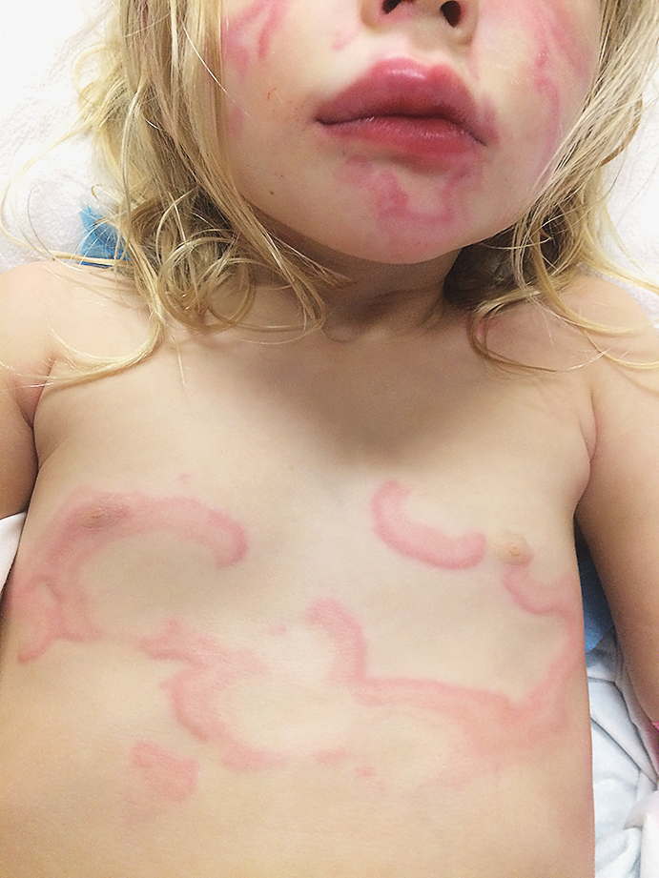
Image Challenge
Q:
What is the diagnosis in this 3-year-old girl with recent upper respiratory infection and new pruritic blanching rash?
1. Erythema multiforme
2. Mastocytosis
3. Urticaria multiforme
4. Henoch-Schonlein purpura
5. Erythema migrans

Slide 2
Image Challenge
Q:
What is the diagnosis in this 3-year-old girl with recent upper respiratory infection and new pruritic blanching rash?
Answer:
Urticaria multiforme
The correct answer is urticaria multiforme. This patient had a recent viral respiratory illness and no history of exposure to new medications or allergens. One week after her illness, she developed fever, along with a generalized polycyclic annular rash with wheals and ecchymotic centers; she then developed acral edema and the blanching arcuate urticarial rash seen here. On examination she was found to have dermatographism, characterized by the onset of welts and hives at the site of pressure or scratching. These clinical features together are most consistent with a diagnosis of urticaria multiforme. The patient was treated with diphenhydramine and the lesions resolved with no further sequelae.

