Slide 1
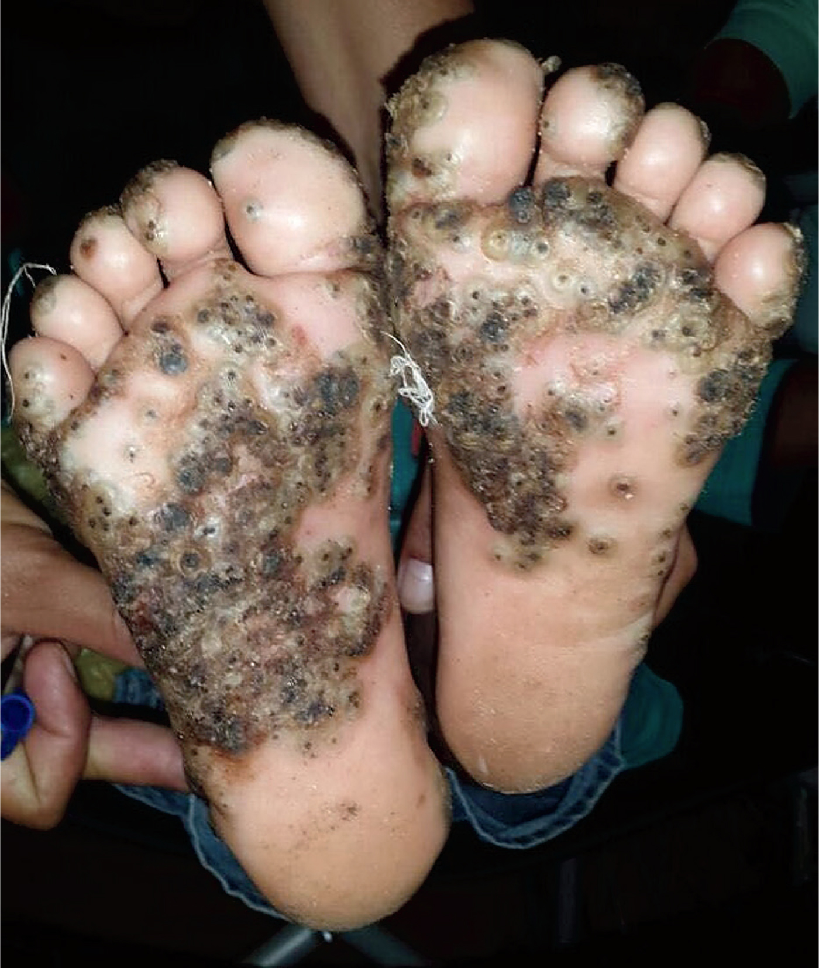
Image Challenge
Q:
An otherwise healthy 10-year-old girl presented to the primary care clinic with a 10-day history of multiple itchy papules on the soles of her feet and on her toes. The lesions had black dots in the center and were painful. Two weeks earlier, the family had traveled to rural Brazil. During that time, the patient had played in a pigsty without wearing shoes. Sand fleas were removed from multiple lesions. What is the most likely diagnosis?
1. Coxsackievirus infection
2. Furuncular myiasis
3. Foreign body granulomas
4. Tungiasis
5. Scabies infestation

Slide 2
Image Challenge
Q:
An otherwise healthy 10-year-old girl presented to the primary care clinic with a 10-day history of multiple itchy papules on the soles of her feet and on her toes. The lesions had black dots in the center and were painful. Two weeks earlier, the family had traveled to rural Brazil. During that time, the patient had played in a pigsty without wearing shoes. Sand fleas were removed from multiple lesions. What is the most likely diagnosis?
Answer:
Tungiasis
The correct answer is tungiasis. Tungiasis is a skin infestation caused by the sand flea Tunga penetrans, an ectoparasite that is found throughout tropical and subtropical parts of the world. Treatment included flea removal and local wound care.

