Slide 1
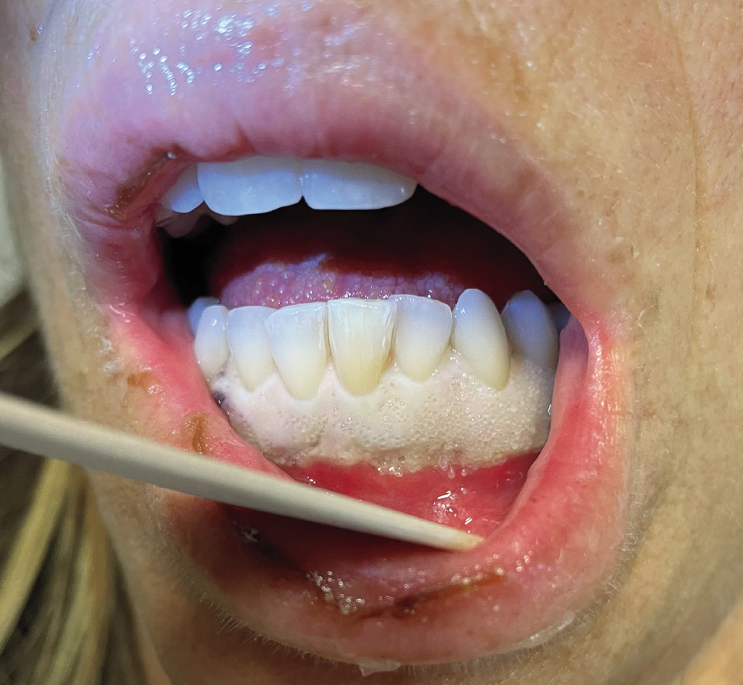
Image Challenge
Q:
A 48-year-old woman presented to the emergency department with a 1-week history of fatigue and painful, swollen gums. On examination, she was febrile and tachycardic with a well-demarcated region of gingival infiltration and whitening and submandibular lymphadenopathy. A white-cell count was 225,000 per cubic millimeter. What is the diagnosis?
1. Gingival candidiasis
2. Leukemic infiltration of the gingiva
3. Oral lichen planus
4. Proliferative verrucous leukoplakia
5. White sponge nevus

Slide 2
Image Challenge
Q:
A 48-year-old woman presented to the emergency department with a 1-week history of fatigue and painful, swollen gums. On examination, she was febrile and tachycardic with a well-demarcated region of gingival infiltration and whitening and submandibular lymphadenopathy. A white-cell count was 225,000 per cubic millimeter. What is the diagnosis?
Answer:
Leukemic infiltration of the gingiva
The correct answer is leukemic infiltration of the gingiva. A bone marrow biopsy showed 89% blasts with positive staining for CD34, CD117, and myeloperoxidase, confirming a diagnosis of acute monocytic leukemia. Gingival infiltration by leukemic cells may be a sign of acute myeloid leukemia, especially in patients with a monocytic subtype. The patient was initiated on treatment with hydroxyurea and chemotherapy. Her gingival swelling improved, and her leukemia went into remission.

