Slide 1
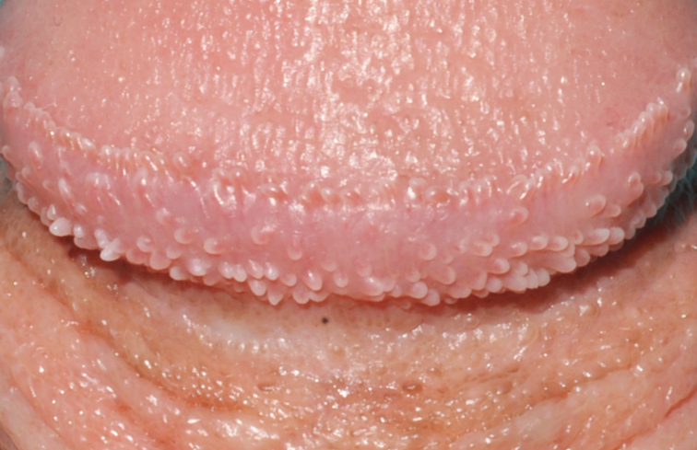
Image Challenge
Q:
A healthy 15-year-old boy presented with a 3-month history of asymptomatic papules on his glans penis. What is the diagnosis?
1. Condyloma acuminatum
2. Fordyce spots
3. Molluscum contagiosum
4. Pearly penile papules
5. Sebaceous hyperplasia

Slide 2
Image Challenge
Q:
A healthy 15-year-old boy presented with a 3-month history of asymptomatic papules on his glans penis. What is the diagnosis?
Answer:
Pearly penile papules
The correct answer is pearly penile papules, a benign anatomical variant that appears during adolescence or early adulthood. Lesions may be misdiagnosed as sexually transmitted infections and cause unnecessary psychological distress.

