Slide 1
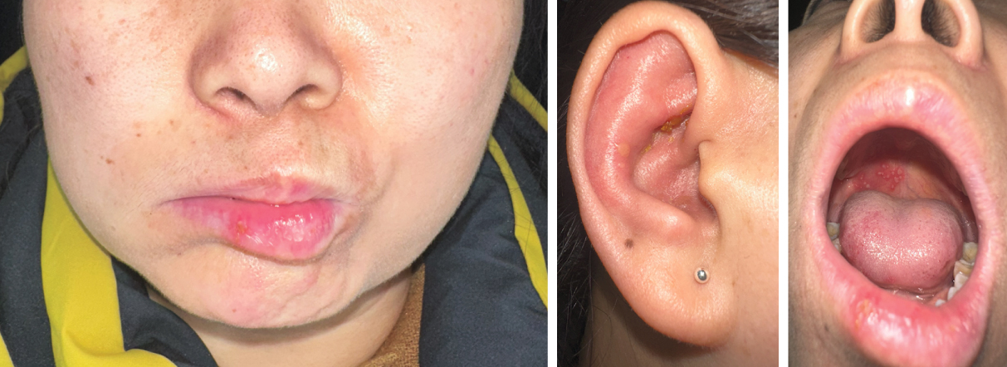
Image Challenge
Q:
A previously healthy 48-year-old woman presented to the dermatology clinic with a 1-day history of a rash on her right ear that was preceded by 2 days of ear pain and an inability to move the right side of her face. Physical examination was notable for facial-nerve palsy on the right side and erythema with a few vesicles and some crusting on the pinna of the right ear. An oral examination revealed vesicles on the right side of the hard palate, patchy erythema of the anterior tongue, and an ulceration on the right lower lip. Her hearing was intact. What is the most likely diagnosis?
1. Aural herpes simplex
2. Bell’s palsy
3. Herpes zoster oticus
4. Malignant otitis externa
5. Sarcoidosis (Heerfordt’s syndrome)

Slide 2
Image Challenge
Q:
A previously healthy 48-year-old woman presented to the dermatology clinic with a 1-day history of a rash on her right ear that was preceded by 2 days of ear pain and an inability to move the right side of her face. Physical examination was notable for facial-nerve palsy on the right side and erythema with a few vesicles and some crusting on the pinna of the right ear. An oral examination revealed vesicles on the right side of the hard palate, patchy erythema of the anterior tongue, and an ulceration on the right lower lip. Her hearing was intact. What is the most likely diagnosis?
Answer:
Herpes zoster oticus
A diagnosis of the Ramsay Hunt syndrome — also known as herpes zoster oticus — was made. The Ramsay Hunt syndrome occurs when varicella–zoster virus reactivates in the geniculate ganglion, a sensory ganglion in the facial nerve that innervates parts of the ear and tongue. Ear pain, ear vesicles, and ipsilateral facial palsy result.

