Slide 1
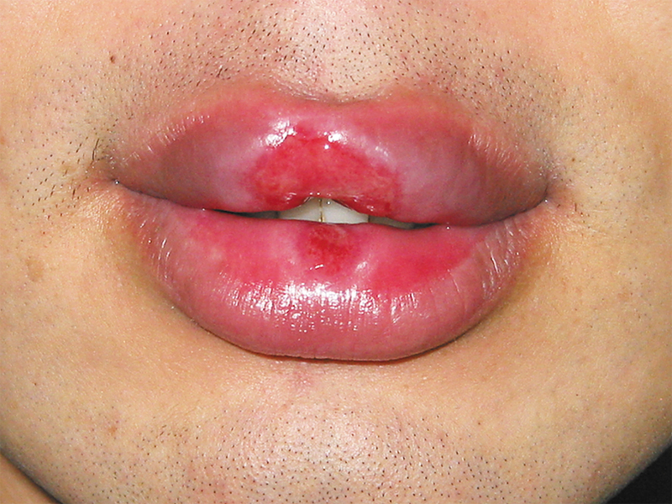
Image Challenge
Q:
These oral ulcers were painless. What is the most likely diagnosis?
1. Chancroid
2. Herpes simplex
3. Iron deficiency
4. Squamous cell cancer
5. Syphilis

Slide 2
Image Challenge
Q:
These oral ulcers were painless. What is the most likely diagnosis?
Answer:
Syphilis
The ulcers have clean, smooth bases and slightly elevated, indurated borders. This type of painless ulcer is typical of a syphilitic chancre. The patient reported having had unprotected orogenital sex with his girlfriend about 2 weeks before the onset of the ulcers. Rapid plasma reagin testing was positive with a titer of at least 1:32. In addition, a Treponema pallidum particle agglutination assay was strongly positive, and a fluorescent treponemal antibody absorption test was positive for both IgG and IgM antibodies. The patient's girlfriend also had positive results on serologic analyses for syphilis, and both were treated successfully with intramuscular penicillin. Chancroid and herpetic ulcers tend to be painful. Cancers do not typically involve both upper and lower lips simultaneously.

