Slide 1
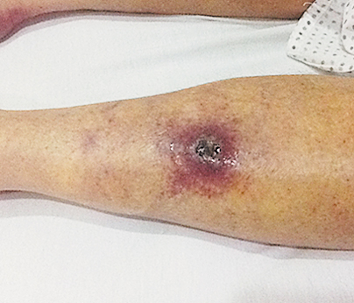
Image Challenge
Q:
What is the diagnosis in this patient who had been bitten by a tsetse fly?
1. Chagas' disease
2. Filariasis
3. Leishmaniasis
4. Trypanosomiasis
5. Tuberculous scrofula

Slide 2
Image Challenge
Q:
What is the diagnosis in this patient who had been bitten by a tsetse fly?
Answer:
Trypanosomiasis
Microscopical examination of blood and fluid from one of the lesions revealed Trypanosoma brucei rhodesiense, which causes human African trypanosomiasis (also called sleeping sickness), which may be an acute, life-threatening disease characterized by fever, parasitemia, and chancre.

