Slide 1
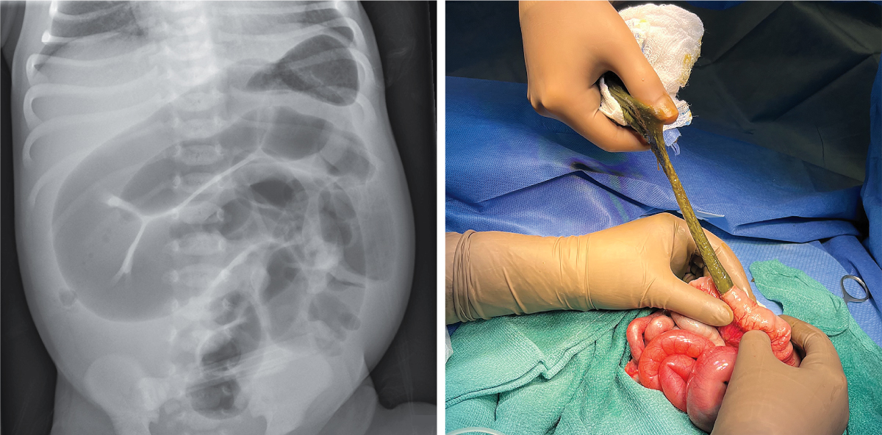
Image Challenge
Q:
A full-term baby boy was transferred to the neonatal intensive care unit (NICU) at 30 hours of age owing to abdominal distention and failure to pass meconium. Before the transfer, the baby had fed poorly and regurgitated colostrum. A nasogastric tube had drained yellow fluid. An abdominal radiograph had shown dilated loops of small intestine. At the NICU, a bedside abdominal ultrasonogram showed possible reversal of the superior mesenteric vessels, and an urgent laparotomy was performed. Considerable distention of the small bowel by thick meconium was identified. Which of the following is the most likely underlying cause of this patient’s symptoms?
1. Congenital chloride diarrhea
2. Cystic fibrosis
3. Hirschsprung’s disease
4. Hypothyroidism
5. Intestinal atresia

Slide 2
Image Challenge
Q:
A full-term baby boy was transferred to the neonatal intensive care unit (NICU) at 30 hours of age owing to abdominal distention and failure to pass meconium. Before the transfer, the baby had fed poorly and regurgitated colostrum. A nasogastric tube had drained yellow fluid. An abdominal radiograph had shown dilated loops of small intestine. At the NICU, a bedside abdominal ultrasonogram showed possible reversal of the superior mesenteric vessels, and an urgent laparotomy was performed. Considerable distention of the small bowel by thick meconium was identified. Which of the following is the most likely underlying cause of this patient’s symptoms?
Answer:
Cystic fibrosis
On postoperative genetic testing, the baby was found to be homozygous for a mutation in CFTR, the gene encoding cystic fibrosis transmembrane conductance regulator. A final diagnosis of meconium ileus due to cystic fibrosis was made. Meconium ileus is small-bowel obstruction caused by meconium impaction.

