Slide 1
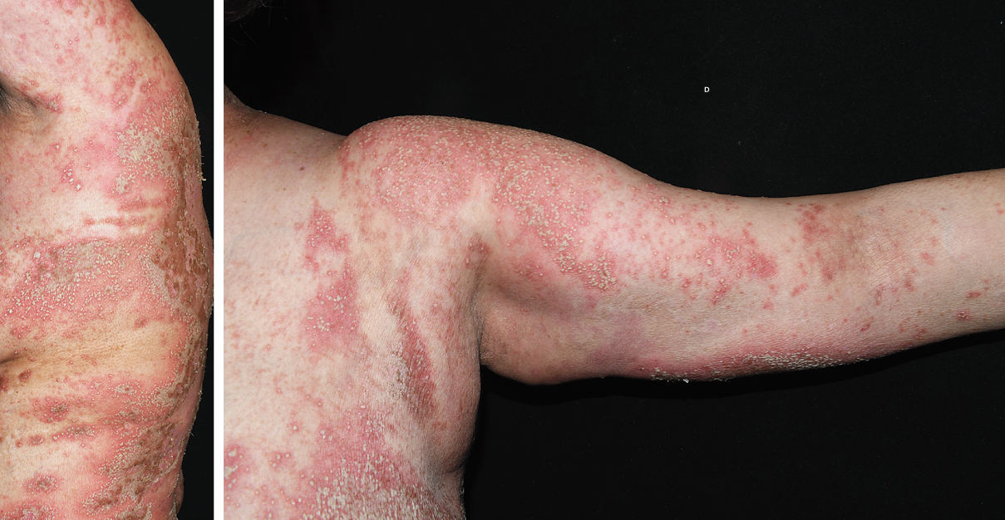
Image Challenge
Q:
A 54-year-old woman with invasive ductal carcinoma of the breast and well-controlled chronic plaque psoriasis presented to the emergency department with a 2-day history of painful rash and fever. Five days before the onset of the rash, the patient had completed a 2-week course of systemic glucocorticoids to treat side effects of chemotherapy. The body temperature was 38.2°C, and heart rate 137 beats per minute. On physical examination, widespread erythematous patches with overlying, coalescing pustules were seen on the torso, arms, legs, face, and scalp, with sparing of mucosal surfaces. Laboratory testing was notable for neutrophilic leukocytosis and an elevated C-reactive protein level. Biopsy of the rash in the periumbilical region revealed neutrophil-rich pustules in the epidermis on histopathological testing. What is the most likely diagnosis?
1. Acute generalized exanthematous pustulosis
2. Generalized pustular psoriasis
3. IgA Pemphigus
4. Staphylococcal scalded skin syndrome
5. Subcorneal pustular dermatosis

Slide 2
Image Challenge
Q:
A 54-year-old woman with invasive ductal carcinoma of the breast and well-controlled chronic plaque psoriasis presented to the emergency department with a 2-day history of painful rash and fever. Five days before the onset of the rash, the patient had completed a 2-week course of systemic glucocorticoids to treat side effects of chemotherapy. The body temperature was 38.2°C, and heart rate 137 beats per minute. On physical examination, widespread erythematous patches with overlying, coalescing pustules were seen on the torso, arms, legs, face, and scalp, with sparing of mucosal surfaces. Laboratory testing was notable for neutrophilic leukocytosis and an elevated C-reactive protein level. Biopsy of the rash in the periumbilical region revealed neutrophil-rich pustules in the epidermis on histopathological testing. What is the most likely diagnosis?
Answer:
Generalized pustular psoriasis
A diagnosis of generalized pustular psoriasis — a rare, autoinflammatory skin disease that manifests as widespread sterile pustules and systemic symptoms — was made. Generalized pustular psoriasis often occurs in patients with plaque psoriasis. It may be spontaneous or triggered by physiological stressors, such as medication withdrawal.

