Slide 1
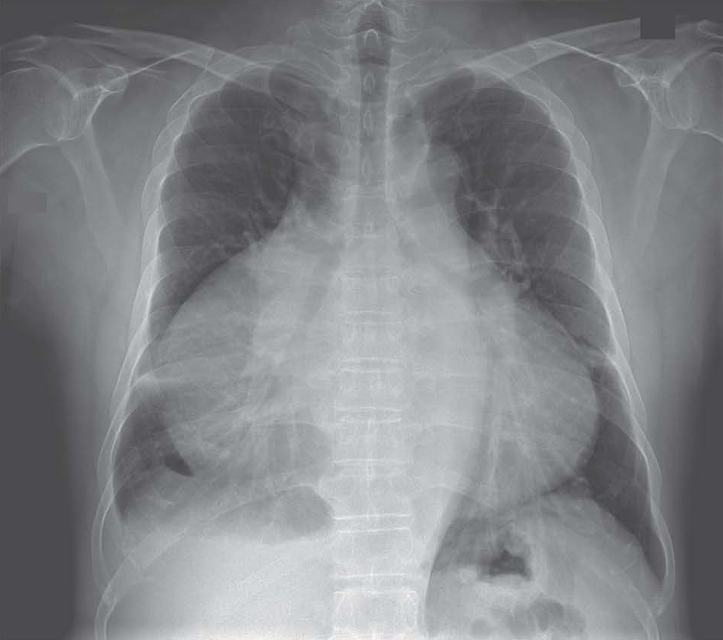
Image Challenge
Q:
A man presented with new peripheral edema. What diagnosis does his chest X-ray suggest?
1. Superior vena cava syndrome
2. Dilated thoracic aorta
3. Right middle lobe pneumonia
4. Cardiac tamponade
5. Giant right atrium

Slide 2
Image Challenge
Q:
A man presented with new peripheral edema. What diagnosis does his chest X-ray suggest?
Answer:
Giant right atrium
The answer is giant right atrium. This man was found to have new atrial fibrillation, tricuspid regurgitation, and right-sided heart failure. Transthoracic echocardiography revealed a giant right atrium, dilated right ventricle, and tricuspid regurgitation. Right atrial enlargement can be caused by pulmonary hypertension, tricuspid-valve stenosis, and Ebstein’s anomaly, but none of these were identified in this patient. Giant right atrium is a rare congenital condition that causes tricuspid regurgitation and right-sided heart failure and can be diagnosed when an alternative cause of right atrial enlargement is not found.

