Slide 1
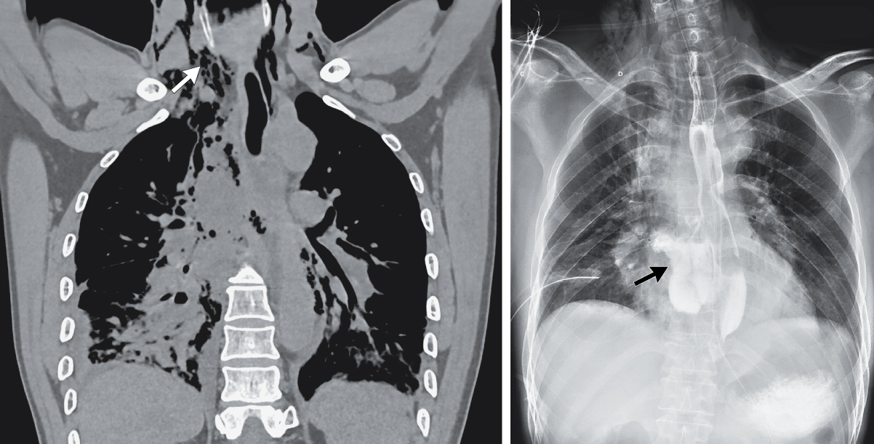
Image Challenge
Q:
A previously healthy 59-year-old man presented to the emergency department with a 5-hour history of severe, pleuritic chest pain. Half an hour before the onset of symptoms, he vomited a large amount of gastric contents after eating street food. On physical examination, his breathing was found to be rapid and shallow. Palpable crepitus was noted in the neck, and breath sounds at the base of the right lung were diminished. Computed tomography of the chest is shown here. What is the most likely diagnosis?
1. Aortoesophageal fistula
2. Aspiration pneumonitis
3. Esophageal rupture
4. Perforated Peptic Ulcer
5. Tension Pneumothorax with subcutaneous emphysema

Slide 2
Image Challenge
Q:
A previously healthy 59-year-old man presented to the emergency department with a 5-hour history of severe, pleuritic chest pain. Half an hour before the onset of symptoms, he vomited a large amount of gastric contents after eating street food. On physical examination, his breathing was found to be rapid and shallow. Palpable crepitus was noted in the neck, and breath sounds at the base of the right lung were diminished. Computed tomography of the chest is shown here. What is the most likely diagnosis?
Answer:
Esophageal rupture
Computed tomography of the chest revealed air in the mediastinum extending up to the neck, a perforation of the esophagus, a pleural effusion on the right side, and atelectasis in the right lung. An esophagram that was obtained with the use of water-soluble contrast material confirmed a large laceration of the esophagus with extravasation of the contrast material into the mediastinum. A diagnosis of the Boerhaave syndrome — life-threatening, spontaneous rupture of the esophagus owing to severe vomiting or retching — was made.

