Slide 1
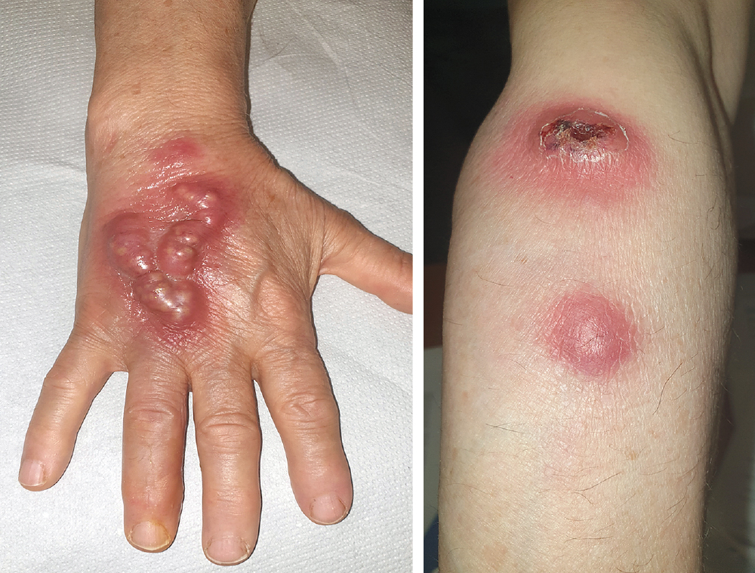
Image Challenge
Q:
A 75-year-old woman presented to the infectious diseases clinic with a 10-day history of painful lesions on the right hand and forearm. An aspiration of the hand lesion was performed. Bacterial culture of the aspirate grew filamentous, gram-positive, acid-fast branching rods. Which of the following activities likely preceded development of the lesions?
1. Cleaning a fish tank
2. Gardening
3. Getting bitten by a sandfly
4. Handling feline waste
5. Petting an armadillo

Slide 2
Image Challenge
Q:
A 75-year-old woman presented to the infectious diseases clinic with a 10-day history of painful lesions on the right hand and forearm. An aspiration of the hand lesion was performed. Bacterial culture of the aspirate grew filamentous, gram-positive, acid-fast branching rods. Which of the following activities likely preceded development of the lesions?
Answer:
Gardening
The nodules had first appeared on the back of her hand at the site of a thorn puncture she had sustained while gardening. The lesions had spread up the hand along a red streak and then had appeared on the forearm. The culture was subsequently identified as Nocardia brasiliensis, and a diagnosis of sporotrichoid nodular lymphangitis was made. After a course of trimethoprim–sulfamethoxazole, the lesions resolved.

