Slide 1
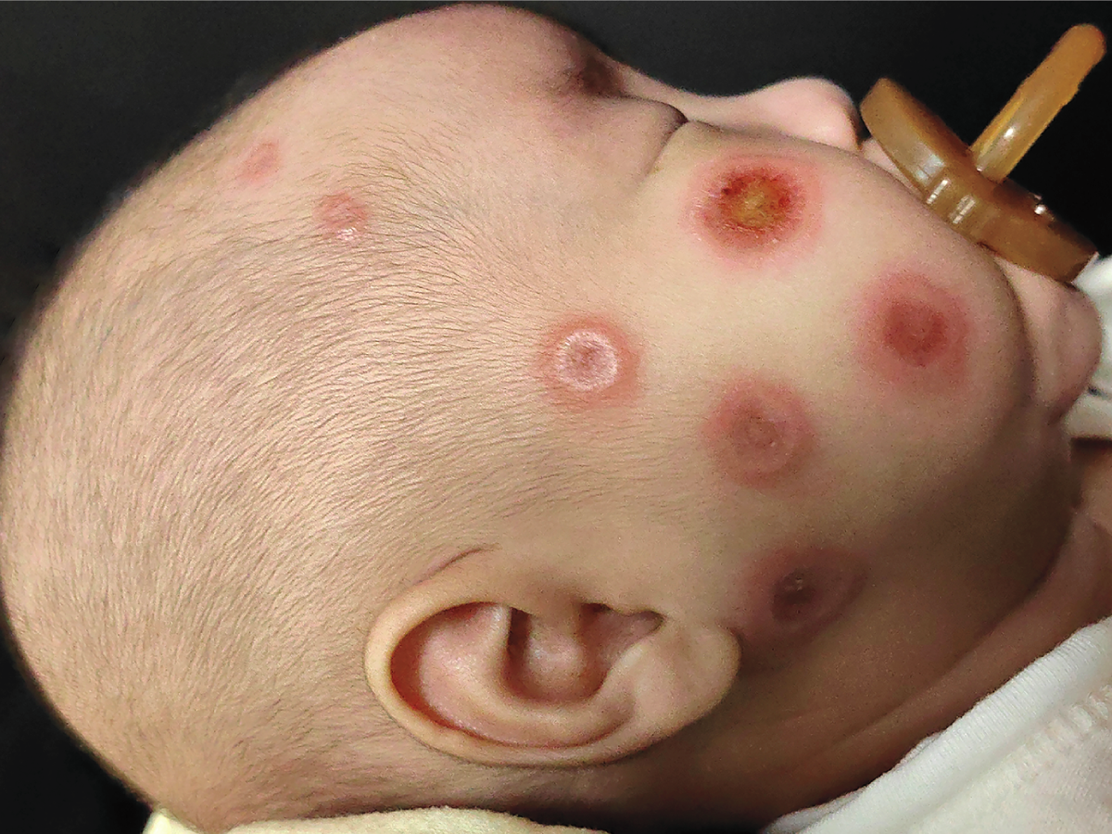
Image Challenge
Q:
A previously healthy, full-term, 2-month-old boy was brought to the dermatology clinic with a 2-week history of annular plaques with edematous borders and central crusting on the face, scalp, and trunk. Results of a complete blood count and comprehensive metabolic panel were normal. Examination of a skin-biopsy sample obtained from the baby’s right forehead showed vacuolar interface dermatitis and perivascular and periadnexal lymphocytic infiltrates. Which of the following is the most likely underlying cause of this baby’s findings?
1. Cutaneous Langerhans cell histiocytosis
2. Impetigo
3. Milia
4. Neonatal lupus erythematosus
5. Tinea corporis

Slide 2
Image Challenge
Q:
A previously healthy, full-term, 2-month-old boy was brought to the dermatology clinic with a 2-week history of annular plaques with edematous borders and central crusting on the face, scalp, and trunk. Results of a complete blood count and comprehensive metabolic panel were normal. Examination of a skin-biopsy sample obtained from the baby’s right forehead showed vacuolar interface dermatitis and perivascular and periadnexal lymphocytic infiltrates. Which of the following is the most likely underlying cause of this baby’s findings?
Answer:
Neonatal lupus erythematosus
Anti-Ro and anti-La antibodies were positive in both the infant and the mother, the latter of whom was asymptomatic and had no history of autoimmune disease. Neonatal lupus results from the passive transfer of maternal anti-Ro and anti-La across the placenta. The associated rash may be present at birth but more often appears several weeks later, after the infant has been exposed to the sun, and is self-limited in nature.

