Slide 1
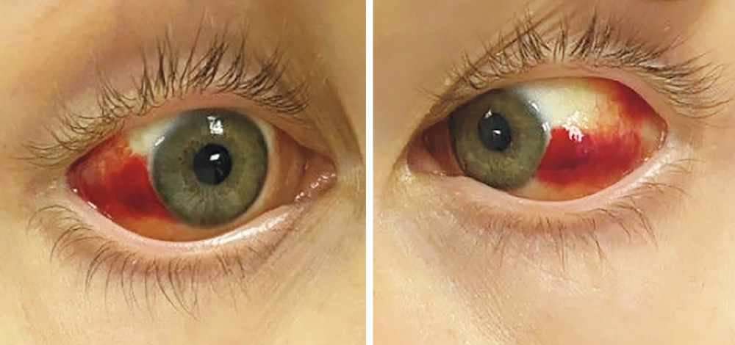
Image Challenge
Q:
An 18-year-old man presented with a 2-day history of fever, vomiting, and diarrhea. Three weeks before presentation, he had fallen into a canal. Physical exam was notable for the findings shown in the image. Laboratory studies showed acute kidney injury and elevations in aminotransferase and total bilirubin levels. What is the most likely diagnosis?
1. Acute hemorrhagic conjunctivitis
2. Ebola hemorrhagic fever
3. Giardiasis
4. Leptospirosis
5. Subarachnoid hemorrhage

Slide 2
Image Challenge
Q:
An 18-year-old man presented with a 2-day history of fever, vomiting, and diarrhea. Three weeks before presentation, he had fallen into a canal. Physical exam was notable for the findings shown in the image. Laboratory studies showed acute kidney injury and elevations in aminotransferase and total bilirubin levels. What is the most likely diagnosis?
Answer:
Leptospirosis
Leptospirosis manifesting as fever, jaundice, renal failure, and hemorrhage was suspected on the basis of the patient’s classic presentation (including the subconjunctival bleeding) and exposure to water with probable contamination by rodent urine. Empirical treatment with intravenous penicillin was initiated. Serum nucleic acid amplification testing identified leptospira species of the serogroup icterohaemorrhagiae. At follow-up 3 weeks later, his symptoms, subconjunctival hemorrhage, and liver and kidney injury had resolved.

