Slide 1
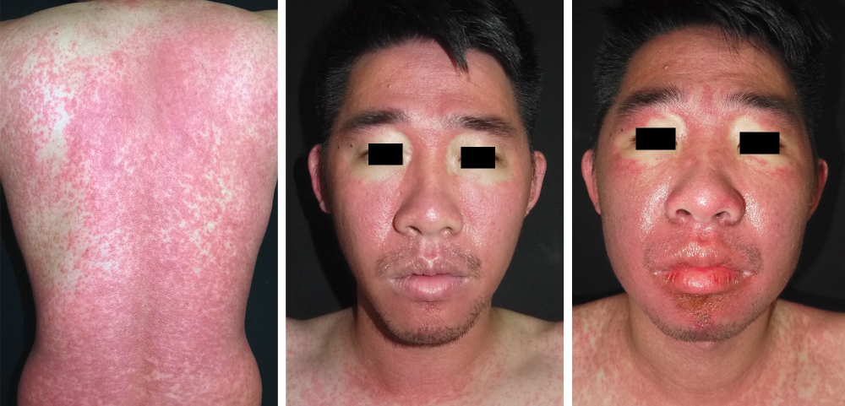
Image Challenge
Q:
A 30-year-old man was admitted to the hospital with 2 weeks of rash and fever that had started one month after taking a course of trimethoprim–sulfamethoxazole for the treatment of folliculitis. Physical examination was notable for fever, a diffuse morbilliform rash, submandibular lymphadenopathy, and facial erythema with periorbital sparing. Four days after admission, facial edema developed. Labs showed elevated absolute eosinophils and aminotransferase levels. What’s the most likely diagnosis?
1. Acute generalized exanthematous pustulosis
2. Drug reaction with eosinophilia and systemic symptoms
3. Erythroderma
4. Hypereosinophilic syndrome
5. Stevens-Johnson syndrome/toxic epidermal necrolysis

Slide 2
Image Challenge
Q:
A 30-year-old man was admitted to the hospital with 2 weeks of rash and fever that had started one month after taking a course of trimethoprim–sulfamethoxazole for the treatment of folliculitis. Physical examination was notable for fever, a diffuse morbilliform rash, submandibular lymphadenopathy, and facial erythema with periorbital sparing. Four days after admission, facial edema developed. Labs showed elevated absolute eosinophils and aminotransferase levels. What’s the most likely diagnosis?
Answer:
Drug reaction with eosinophilia and systemic symptoms
The correct answer is drug reaction with eosinophilia and systemic symptoms. He was treated with systemic glucocorticoids and cyclosporine with improvement of his symptoms and was advised to avoid sulfonamide-containing antibiotics in the future.

