Slide 1
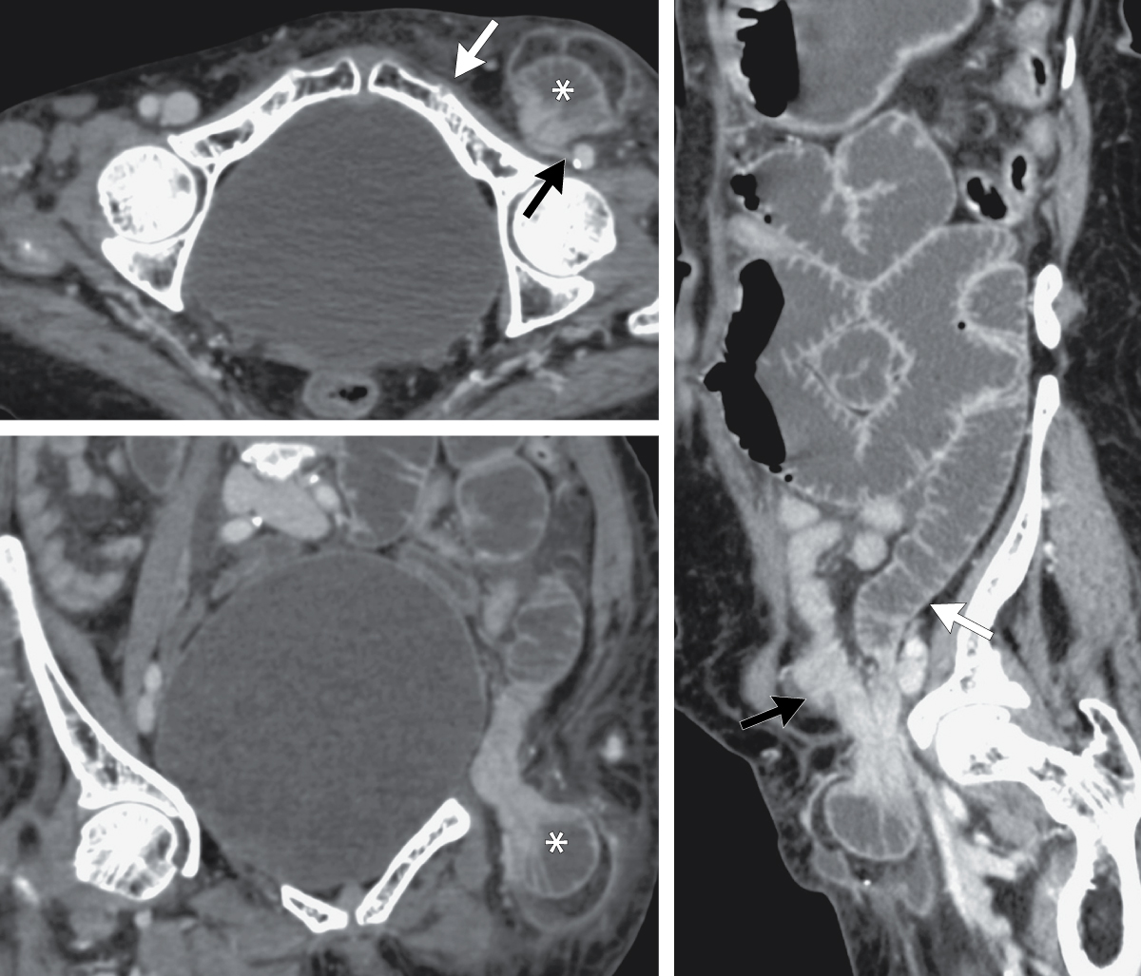
Image Challenge
Q:
A 77-year-old woman presented to the emergency department with a 2-day history of abdominal pain, nausea, and vomiting. On physical examination, there was abdominal distension with tenderness in the left lower quadrant. Computed tomography of the abdomen showed herniation of a loop of ileum on the left side inferior to the inguinal ligament, lateral to the pubic tubercle, and medial to the common femoral vessels with compression the femoral vein. Small bowel loops were dilated proximal to the herniation and collapsed distal to it. What is the most appropriate management for this patient?
1. Bowel regimen
2. Elective surgical repair
3. Emergent surgical repair
4. Manual reduction
5. Nasogastric tube insertion and nil per os

Slide 2
Image Challenge
Q:
A 77-year-old woman presented to the emergency department with a 2-day history of abdominal pain, nausea, and vomiting. On physical examination, there was abdominal distension with tenderness in the left lower quadrant. Computed tomography of the abdomen showed herniation of a loop of ileum on the left side inferior to the inguinal ligament, lateral to the pubic tubercle, and medial to the common femoral vessels with compression the femoral vein. Small bowel loops were dilated proximal to the herniation and collapsed distal to it. What is the most appropriate management for this patient?
Answer:
Emergent surgical repair
The correct answer is emergent surgical repair. The imaging shows an incarcerated femoral hernia. Owing to the small size of the femoral ring, femoral hernias are more likely to incarcerate and strangulate than inguinal hernias. Surgical repair of femoral hernias is thus recommended before complications develop. For this patient, emergent laparotomy with repair of the hernia was performed.

