Slide 1
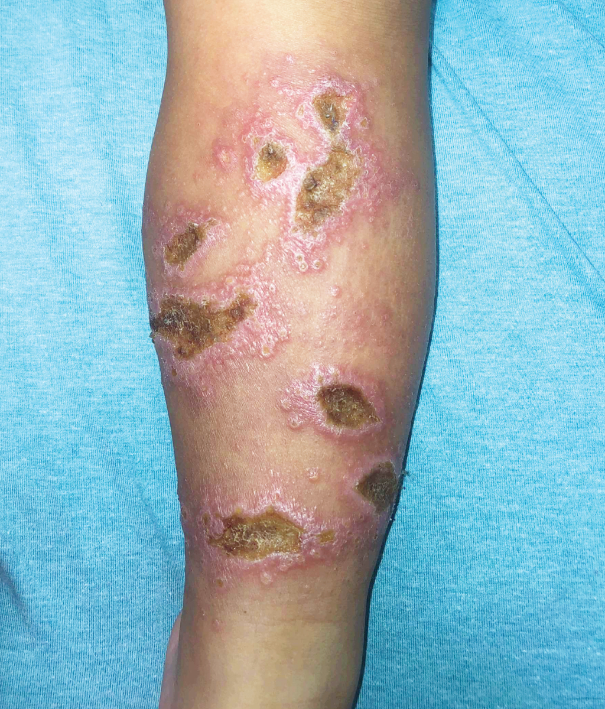
Image Challenge
Q:
A previously healthy 3-year-old boy was brought to the emergency department with a 6-week history of painless bumps and ulcers on his left leg. He initially had itchy insect bites on his foot and then bumps and ulcers had developed slowly on his leg. The boy had recently immigrated from Venezuela after a months-long journey by land with his family. On physical examination, ulcerated plaques with rolled borders and satellite papules were observed on the left lower leg, buttocks, and back. Three biopsy samples were obtained from one of the lesions. Histopathological analysis was notable for severe lymphohistiocytic infiltration with no organisms identified by routine microbiologic stains. What is the most likely diagnosis?
1. Brown recluse spider bites
2. Cutaneous Leishmaniasis
3. Leprosy
4. Phaeohyphomycosis
5. Pyoderma gangrenosum

Slide 2
Image Challenge
Q:
A previously healthy 3-year-old boy was brought to the emergency department with a 6-week history of painless bumps and ulcers on his left leg. He initially had itchy insect bites on his foot and then bumps and ulcers had developed slowly on his leg. The boy had recently immigrated from Venezuela after a months-long journey by land with his family. On physical examination, ulcerated plaques with rolled borders and satellite papules were observed on the left lower leg, buttocks, and back. Three biopsy samples were obtained from one of the lesions. Histopathological analysis was notable for severe lymphohistiocytic infiltration with no organisms identified by routine microbiologic stains. What is the most likely diagnosis?
Answer:
Cutaneous Leishmaniasis
Polymerase-chain-reaction testing of a tissue sample identified Leishmania guyanensis. Leishmaniasis is caused by a protozoa parasite that is transmitted by phlebotomine sandfly bites. Cutaneous leishmaniasis is the most common manifestation of the disease and may result in disfiguring scars. Climate change is affecting the spread of leishmaniasis by altering the geographic distribution and size of sandfly populations. People experiencing poverty and migration are at highest risk for acquiring the infection.

