Slide 1
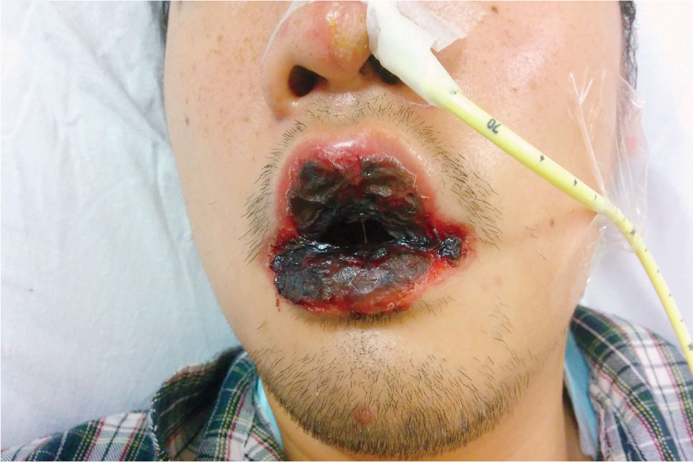
Image Challenge
Q:
A 26-year-old previously healthy man presented to the emergency department with a 3-day history of fever, dry cough, and nonpruritic rash. A physical examination was notable for crackles on the left side of the chest and a macular, targetoid rash on his hands and feet, including the palms and soles. Over the next 3 days, severe mucositis developed that involved the lips, buccal mucosa, conjunctivae, and urethral meatus. What is the diagnosis?
1. Herpes simplex virus-1 gingivostomatitis
2. Stevens–Johnson syndrome
3. Behçet’s disease
4. Mucocutaneous Epstein–Barr virus
5. Mycoplasma pneumoniae-associated mucositis

Slide 2
Image Challenge
Q:
A 26-year-old previously healthy man presented to the emergency department with a 3-day history of fever, dry cough, and nonpruritic rash. A physical examination was notable for crackles on the left side of the chest and a macular, targetoid rash on his hands and feet, including the palms and soles. Over the next 3 days, severe mucositis developed that involved the lips, buccal mucosa, conjunctivae, and urethral meatus. What is the diagnosis?
Answer:
Mycoplasma pneumoniae-associated mucositis
The correct answer is Mycoplasma pneumoniae-associated mucositis. Testing for Mycoplasma pneumoniae by PCR of the nasopharyngeal aspirate and for serum IgM antibody was positive. Mycoplasma is commonly associated with exanthems. In this case, the clinical presentation was consistent with Mycoplasma pneumoniae-induced erythema multiforme, also referred to as mycoplasma-induced rash and mucositis. Given the severity of the mucosal involvement, a nasogastric tube was placed for nutrition and for administration of medications. After approximately 2 weeks of treatment with doxycycline, the patient had complete resolution of his respiratory illness and mucositis.

