Slide 1
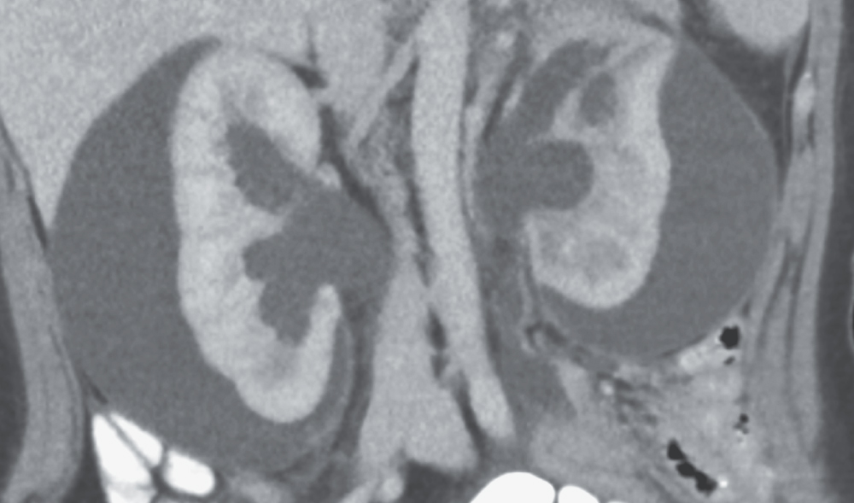
Image Challenge
Q:
A 21-year-old woman with a history of surgically corrected Hirschsprung’s disease presented with 6-week history of abdominal pain and constipation. Her blood pressure was 162/108 mm Hg. She had an elevated creatinine and CT showed large subcapsular urinomas and hydronephrosis caused by distal ureteral obstruction from a rectal mass. What is the likely mechanism of her hypertension?
1. Atherosclerotic renal artery stenosis
2. Fibromuscular dysplasia
3. Medullary sponge kidney
4. Page kidney
5. Polycystic kidney disease

Slide 2
Image Challenge
Q:
A 21-year-old woman with a history of surgically corrected Hirschsprung’s disease presented with 6-week history of abdominal pain and constipation. Her blood pressure was 162/108 mm Hg. She had an elevated creatinine and CT showed large subcapsular urinomas and hydronephrosis caused by distal ureteral obstruction from a rectal mass. What is the likely mechanism of her hypertension?
Answer:
Page kidney
The correct answer is Page kidney. Page kidney refers to the phenomenon whereby external compression of the renal parenchyma impedes renal blood flow, resulting in increased renin secretion and hypertension. The patient underwent percutaneous drainage of the urinomas with normalization of her blood pressure followed by ureteral stenting and biopsy of the rectal mass, which showed adenocarcinoma.

