Slide 1
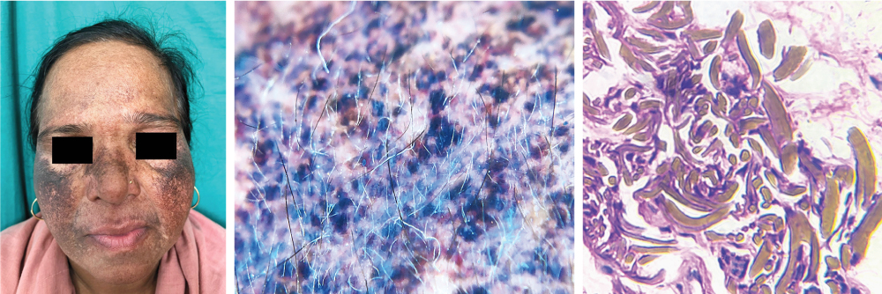
Image Challenge
Q:
A 55-year-old woman presented to the dermatology clinic with a 1-year history of skin darkening on her face. Two years before presentation, she had started applying a skin-lightening cream containing hydroquinone to her face daily to treat melasma. On physical examination, bluish-brown patches with background erythema and telangiectasias were observed on the cheeks, nasal bridge, and perioral region, with lesser involvement on the forehead (left). Dermoscopy of the affected areas revealed hyperchromic, pinpoint macules (middle). A skin-biopsy sample from the left cheek showed extracellular deposition of yellow-brown, banana-shaped bodies in the dermis (right, hematoxylin and eosin stain). What is the most likely diagnosis?
1. Contact dermatitis
2. Eczematous drug eruption
3. Exogenous ochronosis
4. Lichen planus pigmentosus
5. Solar lentigenes

Slide 2
Image Challenge
Q:
A 55-year-old woman presented to the dermatology clinic with a 1-year history of skin darkening on her face. Two years before presentation, she had started applying a skin-lightening cream containing hydroquinone to her face daily to treat melasma. On physical examination, bluish-brown patches with background erythema and telangiectasias were observed on the cheeks, nasal bridge, and perioral region, with lesser involvement on the forehead (left). Dermoscopy of the affected areas revealed hyperchromic, pinpoint macules (middle). A skin-biopsy sample from the left cheek showed extracellular deposition of yellow-brown, banana-shaped bodies in the dermis (right, hematoxylin and eosin stain). What is the most likely diagnosis?
Answer:
Exogenous ochronosis
A diagnosis of exogenous ochronosis from skin-lightening cream was made. Ochronosis is a hyperpigmentation disorder that results from the accumulation of ochre-colored deposits in tissue. It is deemed endogenous when related to alkaptonuria and exogenous when related to the use of skin-lightening agents. Exogenous ochronosis is challenging to treat and may not be reversible. A topical emollient and retinoid gel were prescribed. At 2 months of follow-up, the patient had minimal abatement of the hyperpigmentation.

