Slide 1
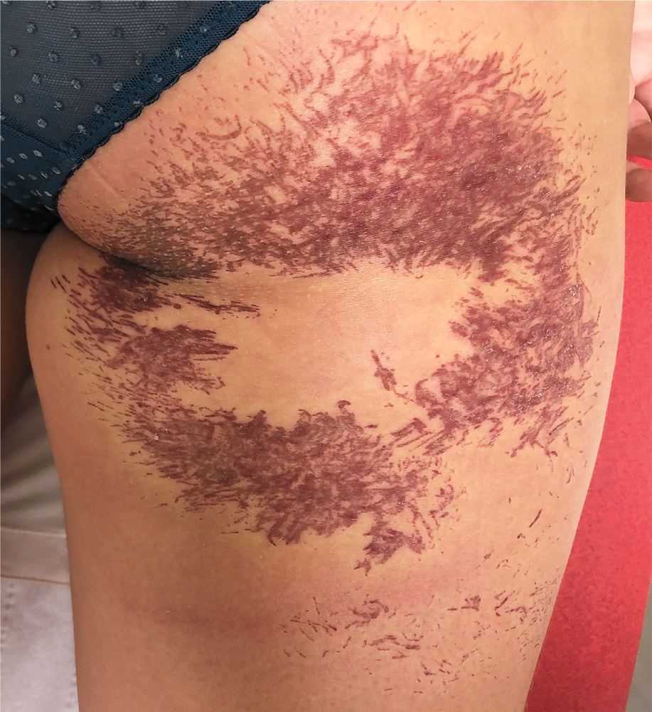
Image Challenge
Q:
A 28-year-old woman presented with a painful rash on her right thigh. Five days before presentation, she had been walking on sea rocks on an island in the Cyclades region of Greece when she fell, landing on her buttocks. She immediately felt a severe pain in her right thigh, and an itchy, red lesion developed. On physical examination at the current presentation, innumerable fine, erythematous, linear lesions in a stellate distribution, with central clearing, on the posterior right thigh were seen. By what marine animal did the patient most likely get stung?
1. Coral
2. Jellyfish
3. Sea anemone
4. Sea urchin
5. Stingray

Slide 2
Image Challenge
Q:
A 28-year-old woman presented with a painful rash on her right thigh. Five days before presentation, she had been walking on sea rocks on an island in the Cyclades region of Greece when she fell, landing on her buttocks. She immediately felt a severe pain in her right thigh, and an itchy, red lesion developed. On physical examination at the current presentation, innumerable fine, erythematous, linear lesions in a stellate distribution, with central clearing, on the posterior right thigh were seen. By what marine animal did the patient most likely get stung?
Answer:
Sea anemone
A diagnosis of sea anemone sting was made. Sea anemone lesions present with painful, circular lesions, often with a central clearing. Skin exposure to sea anemone venom leads to local inflammation at the site of the wound. The Cyclades region of Greece is an area of the Mediterranean known to have a large population of sea anemones.

