Slide 1
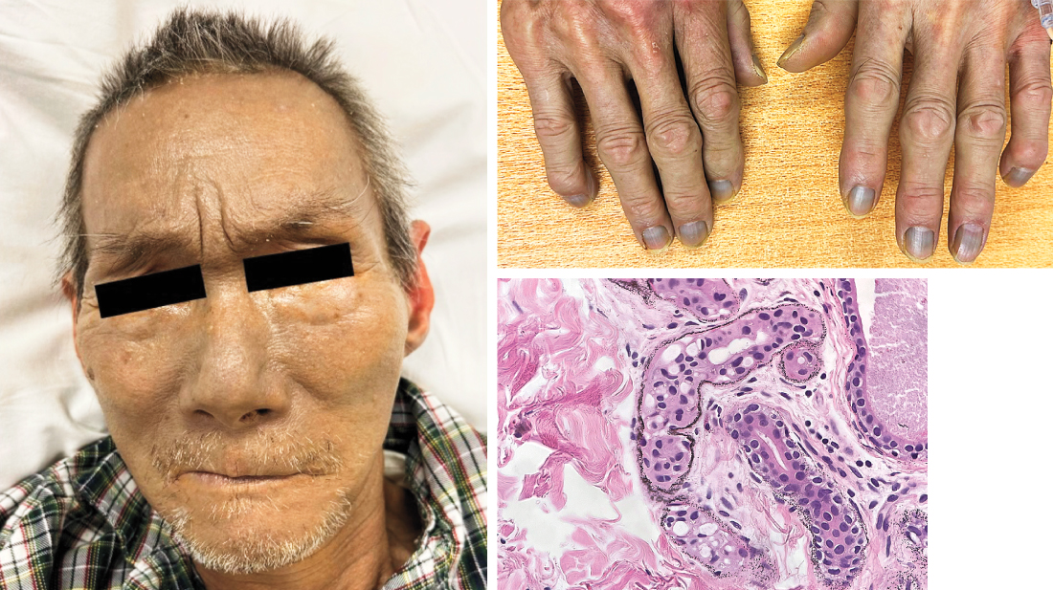
Image Challenge
Q:
An 84-year-old man with benign prostatic hyperplasia who had been admitted to the hospital with acute kidney injury due to obstructive uropathy was noted to have gray skin. The skin changes had been present for 5 years. On physical examination, diffuse slate-gray pigmentation of the skin, particularly on the face, hands and nails, and sclera, was seen. A skin biopsy revealed small, dark granules in the basement membrane of sweat glands and in pilosebaceous units, blood vessels, and elastic fibers in the dermis. What is the diagnosis?
1. Amiodarone-induced hyperpigmentation
2. Argyria
3. Hemochromatosis
4. Minocycline-induced hyperpigmentation
5. Wilson’s disease

Slide 2
Image Challenge
Q:
An 84-year-old man with benign prostatic hyperplasia who had been admitted to the hospital with acute kidney injury due to obstructive uropathy was noted to have gray skin. The skin changes had been present for 5 years. On physical examination, diffuse slate-gray pigmentation of the skin, particularly on the face, hands and nails, and sclera, was seen. A skin biopsy revealed small, dark granules in the basement membrane of sweat glands and in pilosebaceous units, blood vessels, and elastic fibers in the dermis. What is the diagnosis?
Answer:
Argyria
A serum silver level was 423 nmol per liter (reference value, <10). A diagnosis of generalized argyria was made. Generalized argyria is caused by systemic silver exposure leading to an irreversible darkening of skin pigmentation. The changes in skin color are most prominent in sun-exposed areas, because sunlight catalyzes the reduction of elemental silver. The patient had had no meaningful silver exposure in his decades of work as a waiter. He did not use silver-containing products, such as colloidal silver. No other residents in his apartment building had had changes in skin color. On discharge, the patient was referred for further toxicologic evaluation. Ultimately, the source of silver exposure was not identified.

