Slide 1
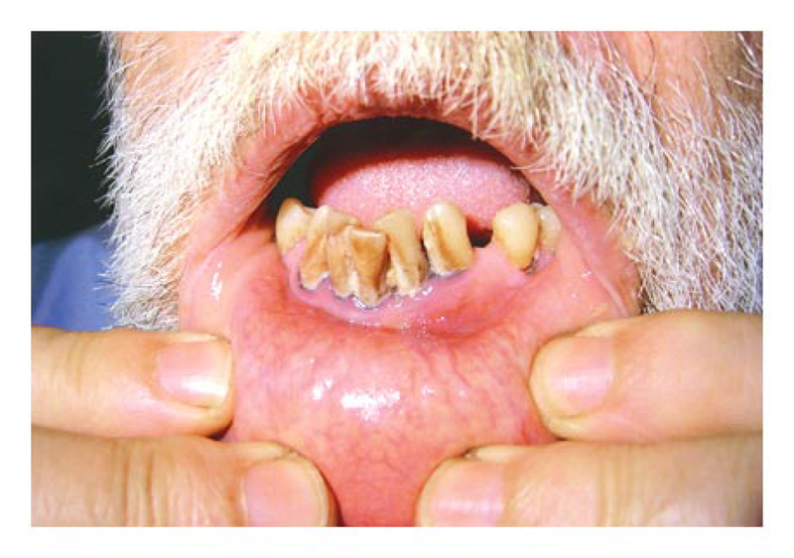
Image Challenge
Q:
This 61-year-old man presented with abdominal pain. Basophilic stippling was evident on a blood smear. What is the most likely diagnosis?
1. Acute myelogenous leukemia
2. Chronic lead poisoning
3. Beta-thallasemia
4. Megaloblastic anemia
5. Sickle cell anemia

Slide 2
Image Challenge
Q:
This 61-year-old man presented with abdominal pain. Basophilic stippling was evident on a blood smear. What is the most likely diagnosis?
Answer:
Chronic lead poisoning
Chronic lead poisoning was the diagnosis in this case. Lead poisoning is associated with abdominal pain, blue discoloration of the gums, and basophilic stippling.

