Slide 1
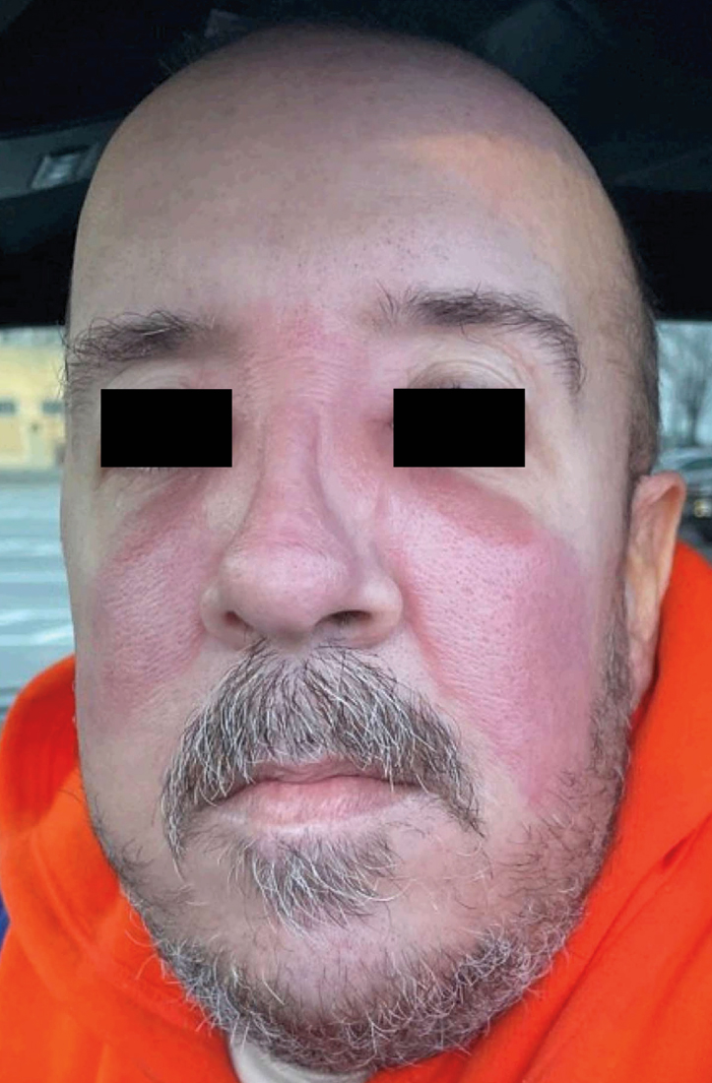
Image Challenge
Q:
A 44-year-old man with Crohn’s disease that was being treated with infliximab presented with a 2-day history of a facial rash. In the previous week, his daughter had had a sore throat, and his mother had developed a similar rash on her face. His heart rate was 96 beats per minute, and his temperature was 36.6°C (97.9°F). Physical examination was notable for well-demarcated, warm, erythematous, confluent plaques on the cheeks, nose, and glabella. The pharynx was normal, and no cervical lymphadenopathy was observed. Which of the following is the most likely culprit organism for the underlying diagnosis?
1. Escherichia coli
2. Pseudomonas aeruginosa
3. Staphylococcus aureus
4. Staphylococcus epidermidis
5. Streptococcus pyogenes

Slide 2
Image Challenge
Q:
A 44-year-old man with Crohn’s disease that was being treated with infliximab presented with a 2-day history of a facial rash. In the previous week, his daughter had had a sore throat, and his mother had developed a similar rash on her face. His heart rate was 96 beats per minute, and his temperature was 36.6°C (97.9°F). Physical examination was notable for well-demarcated, warm, erythematous, confluent plaques on the cheeks, nose, and glabella. The pharynx was normal, and no cervical lymphadenopathy was observed. Which of the following is the most likely culprit organism for the underlying diagnosis?
Answer:
Streptococcus pyogenes
Erysipelas is a skin infection that involves the upper dermis and is most commonly caused by Streptococcus pyogenes (group A Streptococcus). Erysipelas typically manifests as a bright-red rash — often on the malar region of the face — with raised, distinct borders. Most cases can be managed with oral antibacterial agents in the outpatient setting.

