Slide 1
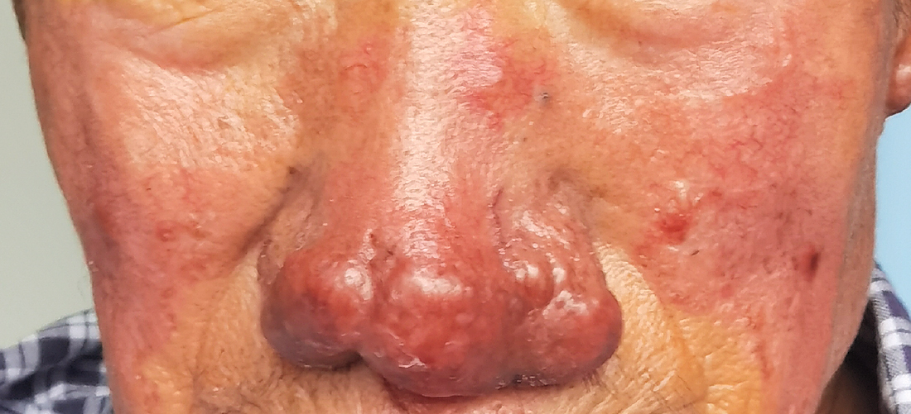
Image Challenge
Q:
A 71-year-old man presented with an 8-year history of enlarging nodules on his nose. On physical examination, he had painless, violaceous, indurated nodules on his nose, ears, fingers, and toes. Computed tomography of the chest revealed hilar and mediastinal lymphadenopathy. Skin biopsy showed non-caseating granulomas. What is the most likely diagnosis?
1. Entomophthoramycosis
2. Leprosy
3. Lupus pernio
4. Lupus vulgaris
5. Rhinophyma

Slide 2
Image Challenge
Q:
A 71-year-old man presented with an 8-year history of enlarging nodules on his nose. On physical examination, he had painless, violaceous, indurated nodules on his nose, ears, fingers, and toes. Computed tomography of the chest revealed hilar and mediastinal lymphadenopathy. Skin biopsy showed non-caseating granulomas. What is the most likely diagnosis?
Answer:
Lupus pernio
A diagnosis of sarcoidosis with lupus pernio was made. Treatment with systemic glucocorticoid therapy was initiated, and at a follow-up visit 6 months after presentation, the nodules had abated.

