Slide 1
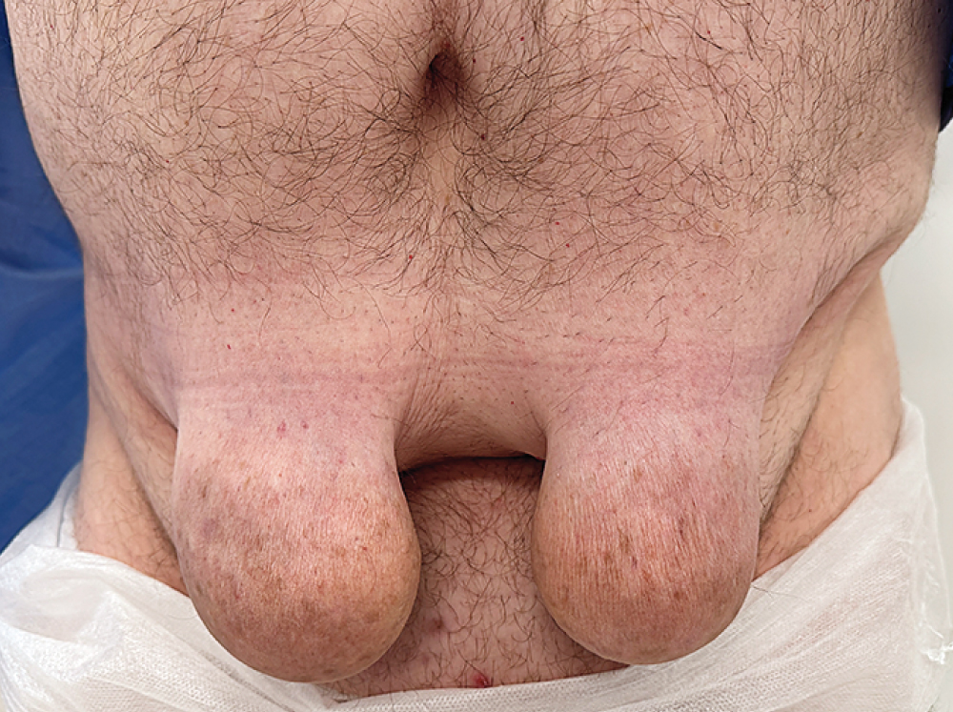
Image Challenge
Q:
A 47-year-old man with type 2 diabetes presented to the endocrinology clinic owing to several years of progressive growth of skin lesions on his lower abdominal wall where he had repeatedly injected insulin. He also reported unpredictable episodes of hypoglycemia. A physical examination was notable for two pendulous skin masses on the lower abdominal wall. The glycated hemoglobin level was 9.2% (reference value, <7.1). What is the most likely diagnosis?
1. Inguinal hernias
2. Injection site granulomas
3. Insulin-derived amyloidosis
4. Lipoatrophy
5. Lipomas

Slide 2
Image Challenge
Q:
A 47-year-old man with type 2 diabetes presented to the endocrinology clinic owing to several years of progressive growth of skin lesions on his lower abdominal wall where he had repeatedly injected insulin. He also reported unpredictable episodes of hypoglycemia. A physical examination was notable for two pendulous skin masses on the lower abdominal wall. The glycated hemoglobin level was 9.2% (reference value, <7.1). What is the most likely diagnosis?
Answer:
Insulin-derived amyloidosis
Insulin-derived amyloidosis is the accumulation of subcutaneous amyloid deposits at sites of repeated insulin injection. Insulin-derived amyloidosis is challenging to differentiate from lipohypertrophy — another cutaneous complication of repeated insulin injections — without histopathological assessment. Both conditions are prevented by frequent rotation of insulin-injection sites. In this case, surgical resection was performed for cosmesis. Histopathological assessment showed amorphous eosinophilic deposits, positive Congo red staining, and apple-green birefringence under polarized light. The specimen also stained positive for thioflavin T under fluorescence.

