Slide 1
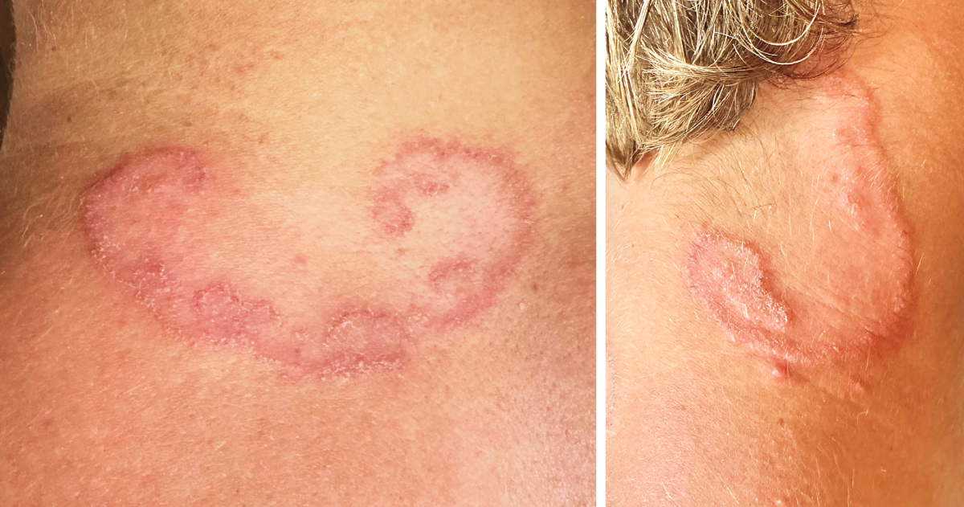
Image Challenge
Q:
A 19-year-old man presented with a 3-week history of an asymptomatic rash on his neck. He worked as a beach lifeguard in southern California and reported no recent international travel. On physical examination, two erythematous, raised, serpiginous eruptions were seen on the neck — one on the posterior surface and another on the right lateral surface. A punch biopsy showed nonspecific inflammation. A potassium hydroxide scraping was negative for fungal elements. What is the diagnosis?
1. Cutaneous larva migrans
2. Larva currens
3. Loiasis
4. Tinea corporis
5. Scabies

Slide 2
Image Challenge
Q:
A 19-year-old man presented with a 3-week history of an asymptomatic rash on his neck. He worked as a beach lifeguard in southern California and reported no recent international travel. On physical examination, two erythematous, raised, serpiginous eruptions were seen on the neck — one on the posterior surface and another on the right lateral surface. A punch biopsy showed nonspecific inflammation. A potassium hydroxide scraping was negative for fungal elements. What is the diagnosis?
Answer:
Cutaneous larva migrans
On the basis of the patient’s occupation and the serpiginous morphologic characteristics of the rash, a diagnosis of cutaneous larva migrans was made. Cutaneous larva migrans results from skin exposure to soil or sand contaminated by the larvae of cat or dog hookworms. In the United States, the infection is usually seen in international travelers, but it may be locally acquired in warmer parts of the country. The rash most often occurs on the feet and ankles, but this patient’s neck involvement was thought to be related to his habit of lying in the sand. Cutaneous larva migrans is typically very itchy. The classic appearance results from the larvae traveling through the epidermis and causing an inflammatory reaction in their wake.

