Slide 1
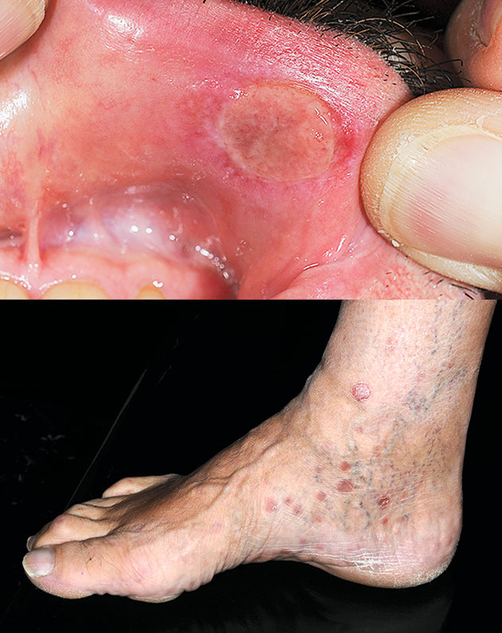
Image Challenge
Q:
Which is the most likely cause for this patient’s erosive, painless upper-lip sore and these findings on the feet?
1. Herpes simplex virus infection
2. Treponema pallidum infection
3. Lymphogranuloma venereum
4. Behcet syndrome
5. Haemophilus ducreyi infection

Slide 2
Image Challenge
Q:
Which is the most likely cause for this patient’s erosive, painless upper-lip sore and these findings on the feet?
Answer:
Treponema pallidum infection
Treponema pallidum infection is the correct answer. It is a gram-negative spirochete that causes syphilis, which is classified into primary, secondary, or tertiary stages of infections that are defined by clinical presentations. Primary syphilis typically presents with painless ulcers, often in the genitalia and usually within the first 3 months of infection. Secondary syphilis usually occurs within 2 months after the resolution of the ulcers and can manifest with nonspecific clinical features such as pharyngitis, fever, and mucocutaneous lesions. Tertiary syphilis typically presents years to decades after the initial infection and commonly manifests with cardiac, neurological, and dermatological features.

