Slide 1
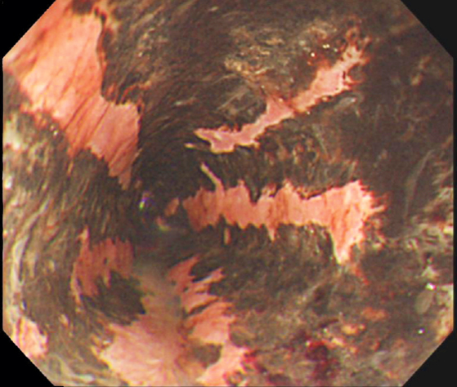
Image Challenge
Q:
A 63-year-old woman with type 2 diabetes presented with a 2-day history of hematemesis and black stool. Esophagogastroduodenoscopy revealed longitudinal, black lesions in the lower esophagus. What is the diagnosis?
1. Malignant melanoma
2. Esophageal acanthosis nigricans
3. Acute esophageal necrosis
4. Esophageal melanocytosis
5. Coal dust deposition

Slide 2
Image Challenge
Q:
A 63-year-old woman with type 2 diabetes presented with a 2-day history of hematemesis and black stool. Esophagogastroduodenoscopy revealed longitudinal, black lesions in the lower esophagus. What is the diagnosis?
Answer:
Acute esophageal necrosis
The correct answer is acute esophageal necrosis. Acute esophageal necrosis is a rare disease characterized by circumferential black appearance of the esophagus. It most commonly occurs in the distal third of the esophagus, which is hypovascular as compared to the proximal segments. Esophageal perforation is a potential acute complication of acute esophageal necrosis, and the development of esophageal strictures can be a long-term risk associated with the disease.

