Slide 1
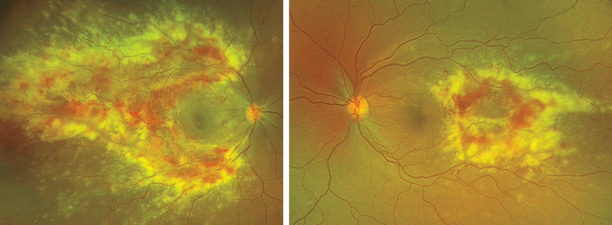
Image Challenge
Q:
A 34-year-old woman with human immunodeficiency virus (HIV) infection presented with a 3-day history of a blind spot in her right eye. One week before the current presentation, the HIV viral load was 57 copies per milliliter (reference value, <20) and the CD4 cell count was 81 per cubic millimeter (reference range, 500 to 1500). On eye examination, visual acuity was 20/50 in the right eye and 20/20 in the left eye. Fundoscopy of the right eye revealed fulminant retinitis with dense areas of retinal necrosis and hemorrhage. The left eye, which had been asymptomatic, had similar changes. What is the diagnosis?
1. Cytomegalovirus retinitis
2. Herpes simplex retinitis
3. HIV retinopathy
4. Retinal vasculitis from ocular syphilis
5. Toxoplasma retinitis

Slide 2
Image Challenge
Q:
A 34-year-old woman with human immunodeficiency virus (HIV) infection presented with a 3-day history of a blind spot in her right eye. One week before the current presentation, the HIV viral load was 57 copies per milliliter (reference value, <20) and the CD4 cell count was 81 per cubic millimeter (reference range, 500 to 1500). On eye examination, visual acuity was 20/50 in the right eye and 20/20 in the left eye. Fundoscopy of the right eye revealed fulminant retinitis with dense areas of retinal necrosis and hemorrhage. The left eye, which had been asymptomatic, had similar changes. What is the diagnosis?
Answer:
Cytomegalovirus retinitis
To confirm a viral retinitis, anterior chamber paracentesis was performed, and a high viral load of cytomegalovirus (CMV) was found on quantitative polymerase-chain-reaction assay. A diagnosis of CMV retinitis was confirmed. CMV retinitis occurs in the context of severe immunosuppression, such as in AIDS. Patients may start to show signs of disease during immune reconstitution, after initiation of antiretroviral therapy.

