Slide 1
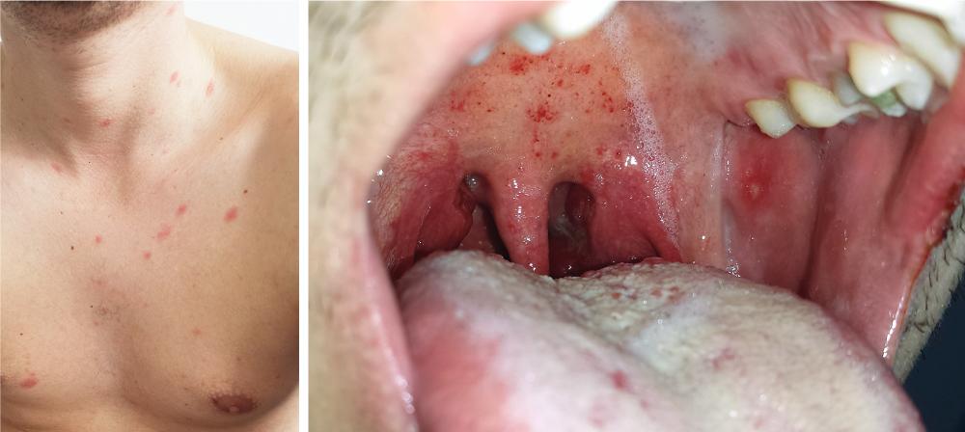
Image Challenge
Q:
A previously healthy 26-year-old man presented to the emergency department with a 5-day history of an asymptomatic rash, sore throat, fevers, chills, and malaise. On physical examination, scattered, erythematous papules and macules could be seen across the upper chest and anterior neck (left). In the mouth, palatal petechiae, buccal mucosal ulcerations, and pharyngeal erythema were observed (right). The patient reported having had condomless sex with a new partner 2 weeks before presentation. A diagnosis of acute Human Immunodeficiency Virus (HIV) infection was made. Which of the following is the first to become positive after a patient is infected with HIV?
1. HIV IgG antibody
2. HIV IgM antibody
3. HIV nucleic acid test
4. p24 antigen
5. Western Blot

Slide 2
Image Challenge
Q:
A previously healthy 26-year-old man presented to the emergency department with a 5-day history of an asymptomatic rash, sore throat, fevers, chills, and malaise. On physical examination, scattered, erythematous papules and macules could be seen across the upper chest and anterior neck (left). In the mouth, palatal petechiae, buccal mucosal ulcerations, and pharyngeal erythema were observed (right). The patient reported having had condomless sex with a new partner 2 weeks before presentation. A diagnosis of acute Human Immunodeficiency Virus (HIV) infection was made. Which of the following is the first to become positive after a patient is infected with HIV?
Answer:
HIV nucleic acid test
The correct answer is HIV nucleic acid test. In acute HIV infection, HIV antibodies do not form until several weeks after infection, whereas HIV viremia and the p24 antigen are detectable much earlier. Western Blot is no longer recommended by the World Health Organization as a preferred diagnostic test for HIV. Antiretroviral therapy was started, and the patient’s symptoms rapidly abated.

