Slide 1
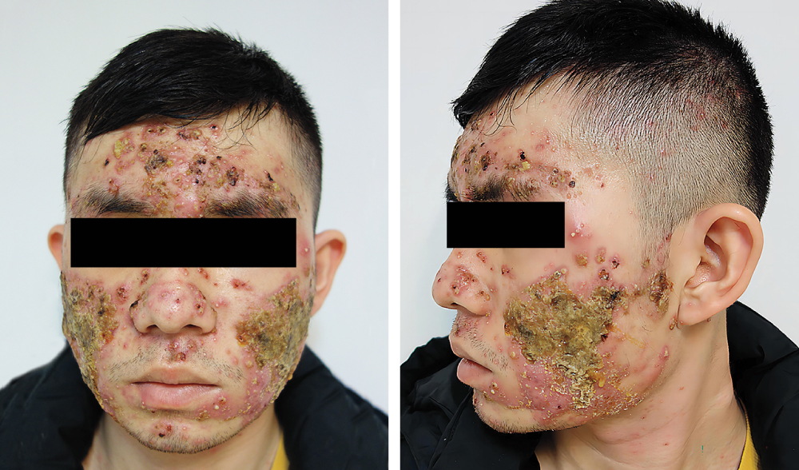
Image Challenge
Q:
A 19-year-old man with a history of mild acne vulgaris presented with a 10-day history of rapidly worsening acne, along with fever, muscle aches, and knee pain. His temperature was 38.5°C. On physical examination, diffuse papulonodular and pustular lesions with areas of overlying crusting were noted across the forehead, nose, cheeks, and chin. There were similar lesions on the neck, shoulders, chest, back, and thighs. Laboratory studies were notable for neutrophilic leukocytosis and an elevated erythrocyte sedimentation rate and C-reactive protein level. A culture of a skin swab grew only Cutibacterium acnes. Histopathological examination of a skin-biopsy specimen taken from behind the left ear showed suppurative folliculitis with adjacent dermal edema. What is the most likely diagnosis?
1. Acne fulminans
2. Acute febrile neutrophilic dermatosis
3. Hidradenitis suppurativa
4. Pustular psoriasis
5. Rosacea fulminans

Slide 2
Image Challenge
Q:
A 19-year-old man with a history of mild acne vulgaris presented with a 10-day history of rapidly worsening acne, along with fever, muscle aches, and knee pain. His temperature was 38.5°C. On physical examination, diffuse papulonodular and pustular lesions with areas of overlying crusting were noted across the forehead, nose, cheeks, and chin. There were similar lesions on the neck, shoulders, chest, back, and thighs. Laboratory studies were notable for neutrophilic leukocytosis and an elevated erythrocyte sedimentation rate and C-reactive protein level. A culture of a skin swab grew only Cutibacterium acnes. Histopathological examination of a skin-biopsy specimen taken from behind the left ear showed suppurative folliculitis with adjacent dermal edema. What is the most likely diagnosis?
Answer:
Acne fulminans
Acne fulminans is an acute, severe variant of inflammatory acne and may be associated with systemic symptoms, such as fever, myalgias, arthralgias, and even osteolytic bone lesions. The condition may be induced by isotretinoin therapy or occur spontaneously, as in this case. Treatment may include oral glucocorticoids, isotretinoin, and topical antimicrobial agents.

