Slide 1
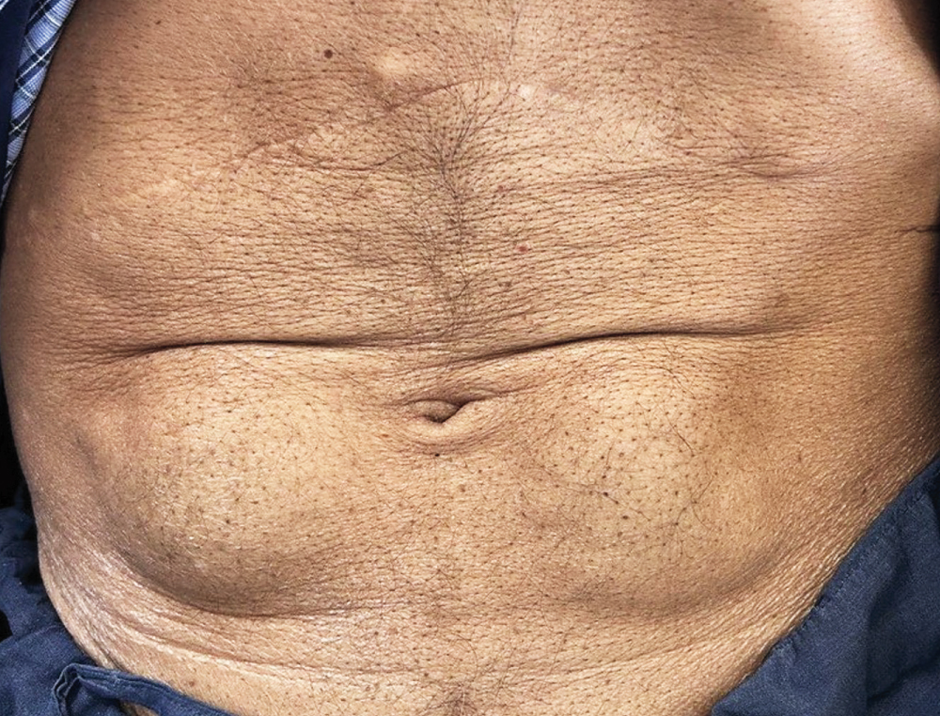
Image Challenge
Q:
A 65-year-old man with type 2 diabetes was admitted to the hospital with hyperosmolar hyperglycemia state. Two weeks before admission, the patient’s insulin dose had been increased owing to inadequate glycemic control. The physical exam was notable for confusion and sarcopenia. There were also rubbery, subcutaneous masses on either side of the umbilicus where the patient had been repeatedly administering insulin injections. Which of the following should be done to prevent this finding?
1. Cool site before injecting
2. Discontinue the use of irritating cleansing solutions at injection sites
3. Massage the injection site after injecting
4. Rotating insulin injection sites
5. Use smaller needles

Slide 2
Image Challenge
Q:
A 65-year-old man with type 2 diabetes was admitted to the hospital with hyperosmolar hyperglycemia state. Two weeks before admission, the patient’s insulin dose had been increased owing to inadequate glycemic control. The physical exam was notable for confusion and sarcopenia. There were also rubbery, subcutaneous masses on either side of the umbilicus where the patient had been repeatedly administering insulin injections. Which of the following should be done to prevent this finding?
Answer:
Rotating insulin injection sites
The skin finding is consistent with insulin-induced lipohypertrophy. Insulin-induced lipohypertrophy is a type of localized lipodystrophy that results from repeated subcutaneous injections at the same site. It may lead to a decreased response to insulin therapy and therefore volatile glycemic levels. Lipohypertrophy may be difficult to detect in patients with obesity, but masses are usually palpable on abdominal examination. Patients who use subcutaneous insulin should be examined for injection-site complications at every clinic visit and should receive counseling regarding the importance of rotating injection sites to allow sites to heal.

