Slide 1
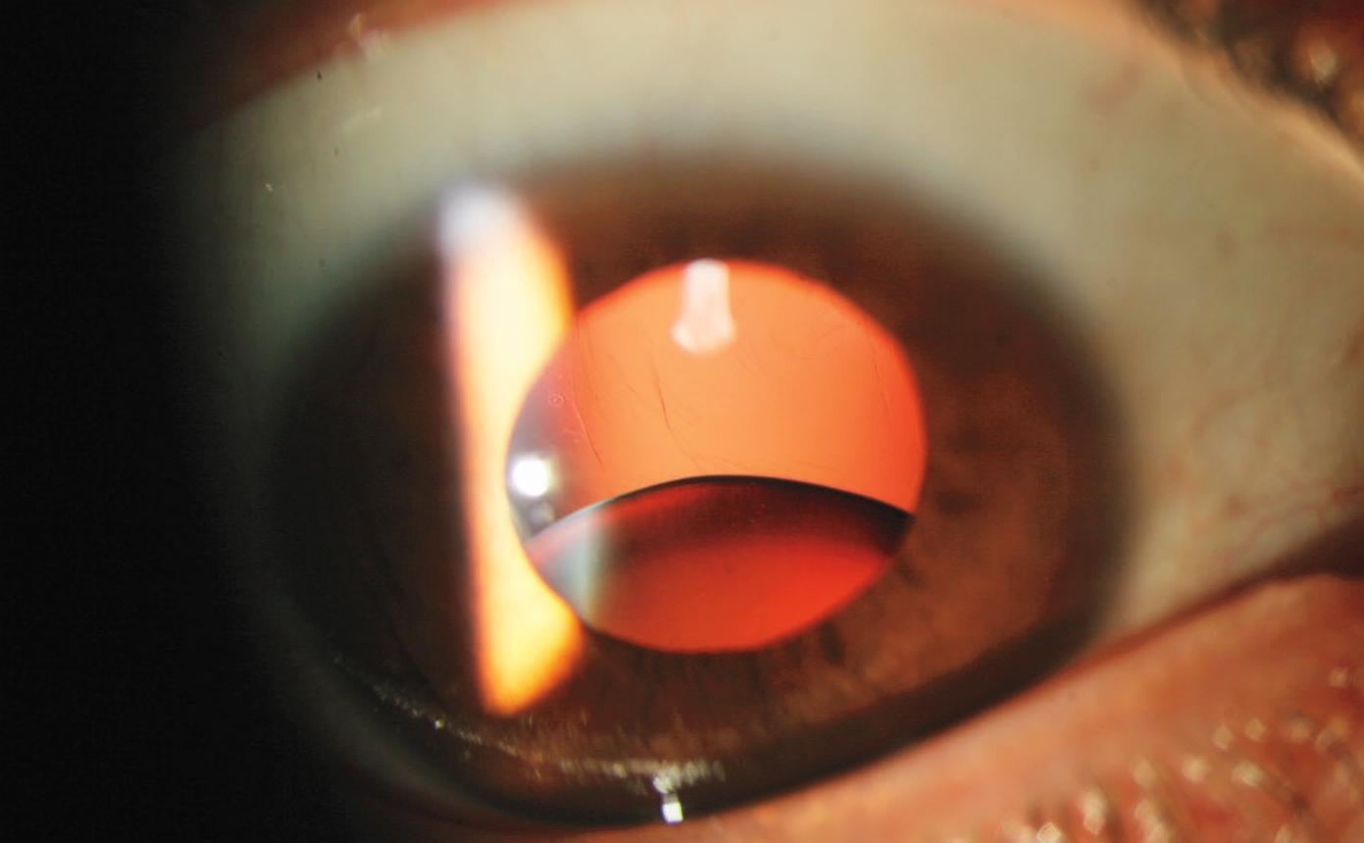
Image Challenge
Q:
A 41-year-old man presented with progressive loss of vision in both eyes. Physical examination was notable for pectus excavatum and elongated digits. His uncorrected visual acuity was 6/200 in the right eye and 20/100 in the left eye. What is the diagnosis?
1. Pseudoexfoliation glaucoma
2. Retinal detachment
3. Ectopia lentis
4. Traumatic cataract
5. Iridocyclitis

Slide 2
Image Challenge
Q:
A 41-year-old man presented with progressive loss of vision in both eyes. Physical examination was notable for pectus excavatum and elongated digits. His uncorrected visual acuity was 6/200 in the right eye and 20/100 in the left eye. What is the diagnosis?
Answer:
Ectopia lentis
The correct answer is ectopia lentis. Ectopia lentis, the total or partial dislocation of the lens, is a characteristic sign in patients with Marfan’s syndrome. Ectopia lentis is caused by dysfunction in zonular fibers, the suspensory strands of the lens, which are responsible for stabilizing the lens within the eye.

