Slide 1
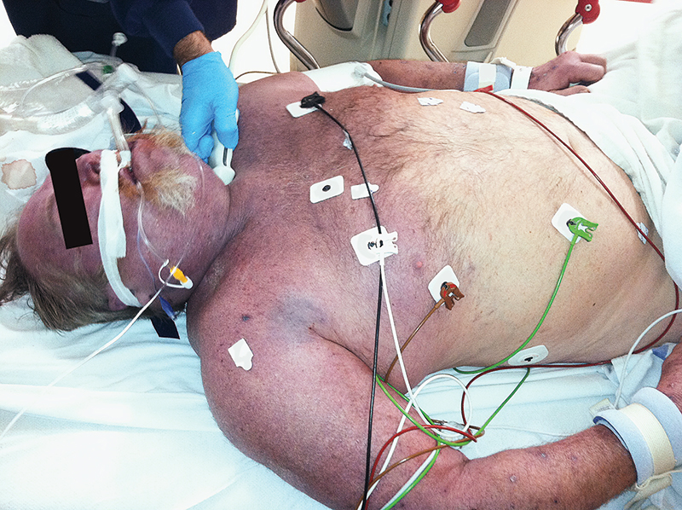
Image Challenge
Q:
What is the diagnosis?
1. Angioedema
2. Cardiac tamponade
3. Necrotizing fasciitis
4. Superior vena cava syndrome
5. Toxic epidermal necrolysis

Slide 2
Image Challenge
Q:
What is the diagnosis?
Answer:
Superior vena cava syndrome
The cyanosis that is limited to the head, neck, upper torso, and arms is consistent with superior vena cava syndrome, which was confirmed with venography. The patient recovered following treatment with ultrasound-accelerated thrombolysis.

