Slide 1
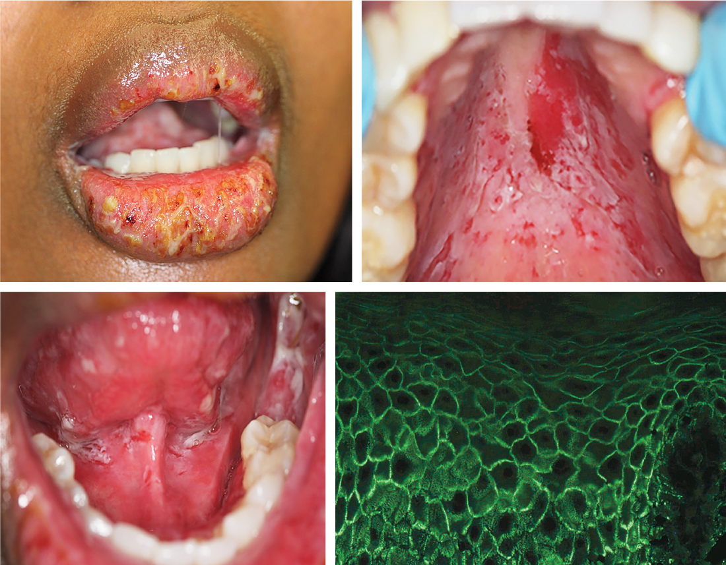
Image Challenge
Q:
A previously healthy 44-year-old woman presented to the oral medicine clinic with an 11-month history of mouth ulcers and blistered lips. The lesions had caused pain while eating, with resultant unintentional weight loss. She also reported a 6-month history of skin blisters on her arms and legs. On physical examination, the lips were swollen with bleeding erosions and yellow pustules. Erosions were seen on the hard palate, as well as on the floor of the mouth, tongue, and buccal mucosa. Gingivitis and halitosis were also present. Flaccid bullae and blisters were seen on the skin of the arms and legs. Biopsy of the gingiva revealed intraepithelial separation and retention of basal cells along the basement membrane. Direct immunofluorescence of the biopsy specimen showed IgG deposition along epithelial-cell membranes, resulting in a “chicken wire” pattern. What is the most likely diagnosis?
1. Behcet’s disease
2. Bullous pemphigoid
3. Linear IgA bullous dermatosis
4. Pemphigus foliaceus
5. Pemphigus vulgaris

Slide 2
Image Challenge
Q:
A previously healthy 44-year-old woman presented to the oral medicine clinic with an 11-month history of mouth ulcers and blistered lips. The lesions had caused pain while eating, with resultant unintentional weight loss. She also reported a 6-month history of skin blisters on her arms and legs. On physical examination, the lips were swollen with bleeding erosions and yellow pustules. Erosions were seen on the hard palate, as well as on the floor of the mouth, tongue, and buccal mucosa. Gingivitis and halitosis were also present. Flaccid bullae and blisters were seen on the skin of the arms and legs. Biopsy of the gingiva revealed intraepithelial separation and retention of basal cells along the basement membrane. Direct immunofluorescence of the biopsy specimen showed IgG deposition along epithelial-cell membranes, resulting in a “chicken wire” pattern. What is the most likely diagnosis?
Answer:
Pemphigus vulgaris
Pemphigus vulgaris is an autoimmune, blistering mucocutaneous disorder. Mucosal involvement develops in almost all patients with pemphigus vulgaris, with oral lesions preceding the skin lesions in roughly half the patients.

