Slide 1
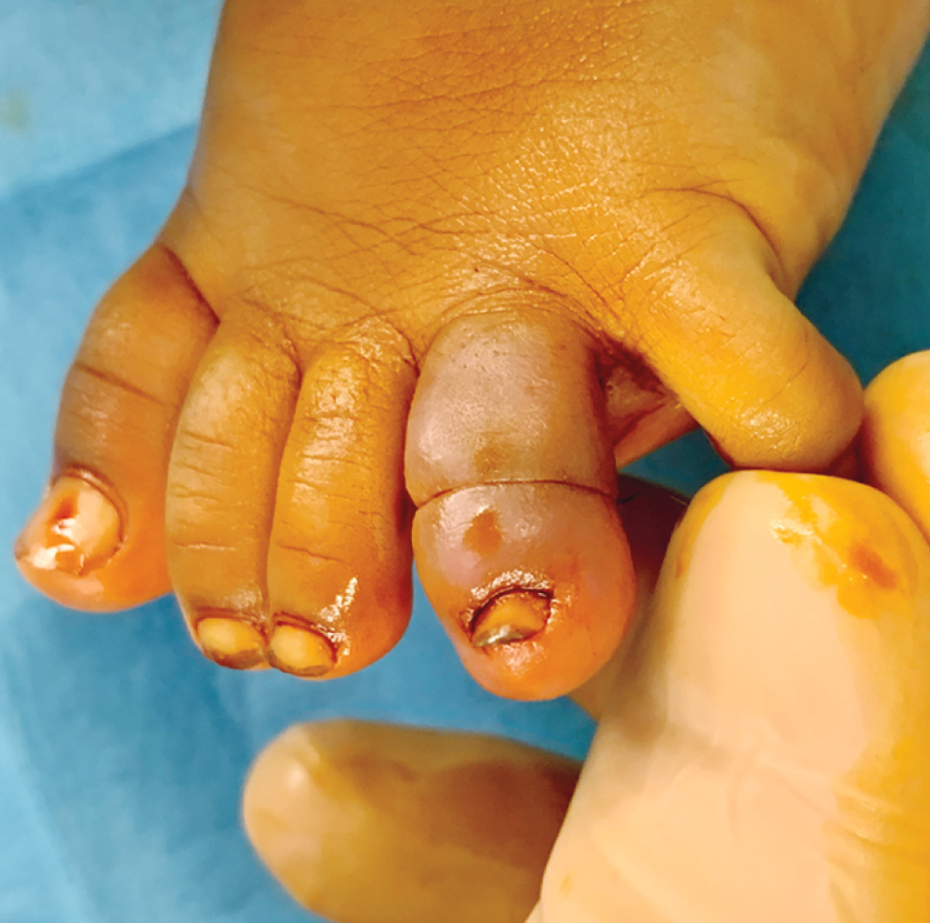
Image Challenge
Q:
A 6-month-old girl was brought to the emergency department with a 3-day history of redness and swelling of a toe. A physical examination is shown. Which of the following is the most likely underlying cause of the findings?
1. Allergic reaction
2. Cellulitis
3. Hair tourniquet
4. Non-accidental trauma
5. Insect bite

Slide 2
Image Challenge
Q:
A 6-month-old girl was brought to the emergency department with a 3-day history of redness and swelling of a toe. A physical examination is shown. Which of the following is the most likely underlying cause of the findings?
Answer:
Hair tourniquet
A diagnosis of hair tourniquet was made. This condition is characterized by a tightly wound hair or thread coiled around an appendage, most commonly a toe. The constriction may lead to pain, swelling, and ultimately ischemia. Treatment involves application of a chemical depilatory agent or manual removal of the hair for superficial cases, or surgery for deeper tourniquets.

