Slide 1
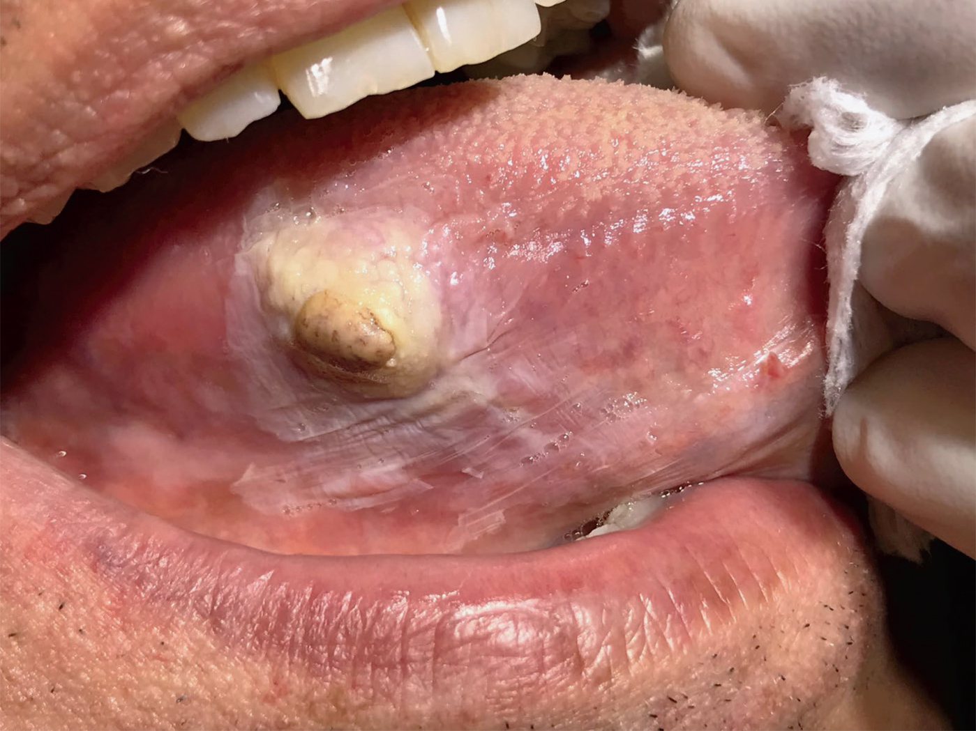
Image Challenge
Q:
A 54-year-old man presented to the oral and maxillofacial clinic with a 2-month history of difficulty chewing his food. He reported a painless brown lesion had grown on his tongue in the center of a white patch that had been present for years. Examination of the oral cavity revealed a well-circumscribed hard mass, measuring 8 mm by 7 mm and surrounded by a white patch on the right side of the tongue. What is the most likely diagnosis?
1. Dermoid cyst
2. Oral candidiasis
3. Lipoma
4. Spindle-cell sarcoma
5. Tongue mucocele

Slide 2
Image Challenge
Q:
A 54-year-old man presented to the oral and maxillofacial clinic with a 2-month history of difficulty chewing his food. He reported a painless brown lesion had grown on his tongue in the center of a white patch that had been present for years. Examination of the oral cavity revealed a well-circumscribed hard mass, measuring 8 mm by 7 mm and surrounded by a white patch on the right side of the tongue. What is the most likely diagnosis?
Answer:
Spindle-cell sarcoma
An incisional biopsy revealed a high-grade, undifferentiated spindle-cell sarcoma. This is a rare connective-tissue tumor that can grow rapidly. The patient underwent surgery and received adjuvant chemotherapy. At follow-up 1 year after the completion of chemotherapy, he had no evidence of recurrence.

