Slide 1
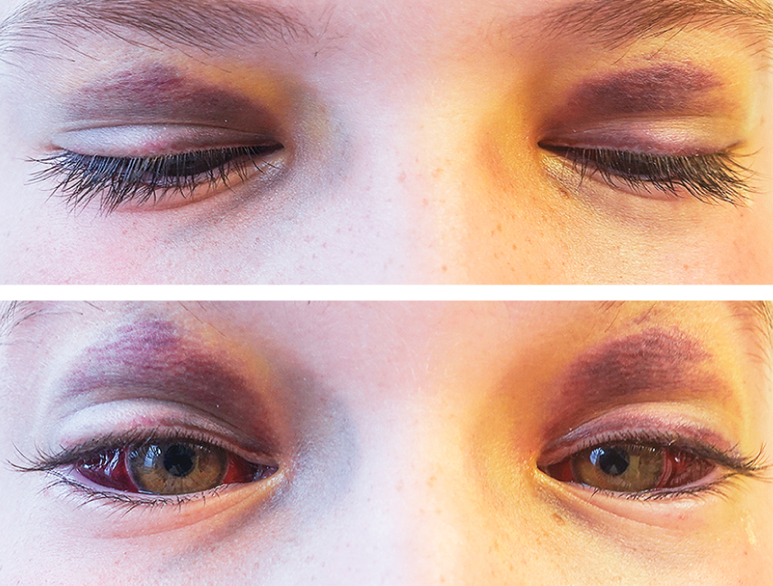
Image Challenge
Q:
A previously healthy 10-year-old boy was brought to the pediatric emergency department with a 4-day history of progressively worsening bruising around the eyelids. Four weeks prior, he developed a dry cough, which had intensified over the previous week. The patient was up to date on routine vaccinations and had no history of trauma or bleeding disorders. On physical examination, ecchymosis was noted on the eyelids, along with subconjunctival hemorrhages in both eyes. A complete ophthalmologic examination was otherwise normal. Which of the following is the most likely etiology of the patient’s symptoms and findings?
1. Acute lymphoblastic leukemia
2. Influenza
3. Inhaled foreign body
4. Leptospirosis
5. Pertussis

Slide 2
Image Challenge
Q:
A previously healthy 10-year-old boy was brought to the pediatric emergency department with a 4-day history of progressively worsening bruising around the eyelids. Four weeks prior, he developed a dry cough, which had intensified over the previous week. The patient was up to date on routine vaccinations and had no history of trauma or bleeding disorders. On physical examination, ecchymosis was noted on the eyelids, along with subconjunctival hemorrhages in both eyes. A complete ophthalmologic examination was otherwise normal. Which of the following is the most likely etiology of the patient’s symptoms and findings?
Answer:
Pertussis
A polymerase-chain-reaction assay from a nasopharyngeal swab specimen was positive for Bordetella pertussis. A diagnosis of eyelid ecchymoses and subconjunctival hemorrhages owing to pertussis was made. In pertussis (also known as whooping cough), small blood vessels in and around the eyes may rupture when venous pressures increase as a result of intense paroxysms of coughing. Other complications of severe coughing include rib fracture, pneumothorax, and syncope.

