Slide 1
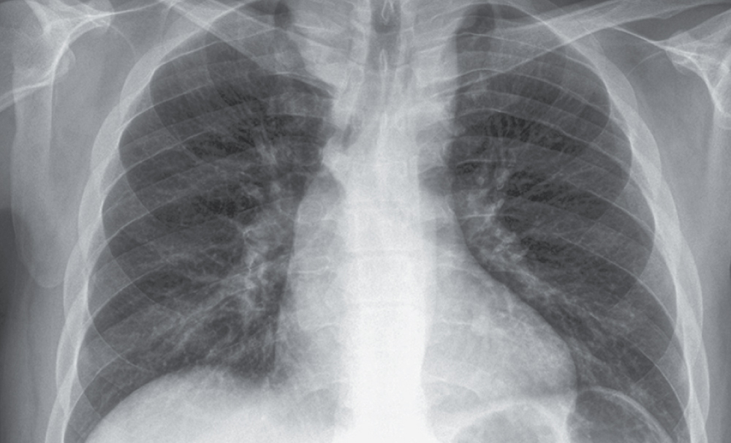
Image Challenge
Q:
A 35-year-old man presented to his primary care physician for evaluation of previously unknown asymptomatic hypertension. The blood pressure was 146/89 mm Hg in the left arm, 146/99 mm Hg in the right arm, 104/83 mm Hg in the left leg, and 109/90 mm Hg in the right leg. Radiograph of the chest is shown. Which of the following findings would not be typical of this condition?
1. Collateral arterial circulation
2. Continuous murmur
3. Left ventricular hypertrophy
4. Radial-femoral delay
5. Rib notching

Slide 2
Image Challenge
Q:
A 35-year-old man presented to his primary care physician for evaluation of previously unknown asymptomatic hypertension. The blood pressure was 146/89 mm Hg in the left arm, 146/99 mm Hg in the right arm, 104/83 mm Hg in the left leg, and 109/90 mm Hg in the right leg. Radiograph of the chest is shown. Which of the following findings would not be typical of this condition?
Answer:
Continuous murmur
The correct answer is a continuous murmur. This patient was diagnosed with coarctation of the descending aorta. He was found to have rib notching from extensive collateral arterial circulation, left ventricular hypertrophy, and a radial-femoral delay. Percutaneous stenting of the aortic coarctation was performed without complications. At one-month follow-up, his blood pressure had improved. At 3-month follow-up, repeat imaging showed a marked decrease in collateral arterial circulation.

