Slide 1
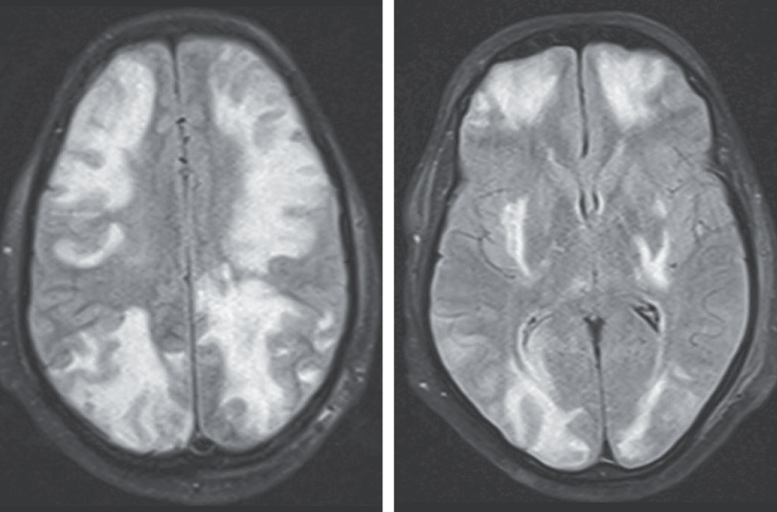
Image Challenge
Q:
A 35-year-old man with IgA nephropathy presented with confusion, blurry vision, and seizures. Two weeks before presentation, he had started receiving cyclosporine. Physical examination was notable for a blood pressure of 160/80 mm Hg, drowsiness, and decreased visual acuity. A fundoscopic examinations was normal. T2-weighted magnetic resonance imaging (MRI) with fluid-attenuated inversion recovery sequencing of the head was performed. What is the most likely diagnosis?
1. Acute demyelinating encephalomyelitis
2. Methanol ingestion
3. Multifocal ischemic infarcts
4. Posterior reversible encephalopathy syndrome
5. West Nile virus encephalitis

Slide 2
Image Challenge
Q:
A 35-year-old man with IgA nephropathy presented with confusion, blurry vision, and seizures. Two weeks before presentation, he had started receiving cyclosporine. Physical examination was notable for a blood pressure of 160/80 mm Hg, drowsiness, and decreased visual acuity. A fundoscopic examinations was normal. T2-weighted magnetic resonance imaging (MRI) with fluid-attenuated inversion recovery sequencing of the head was performed. What is the most likely diagnosis?
Answer:
Posterior reversible encephalopathy syndrome
A diagnosis of posterior reversible encephalopathy syndrome (PRES) due to cyclosporine use was made. One week after cyclosporine therapy was stopped, the patient’s symptoms and MRI findings had resolved.

