Slide 1
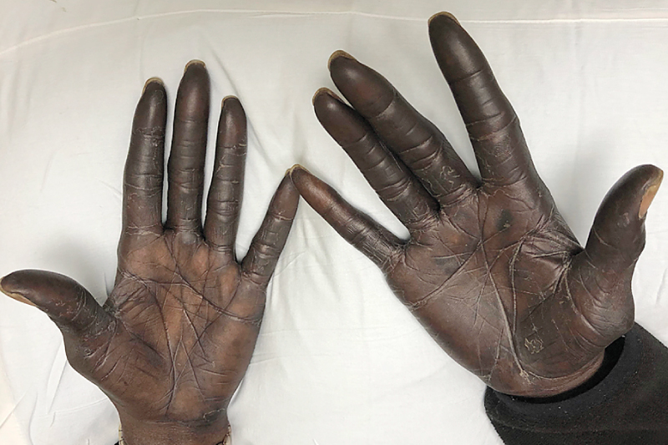
Image Challenge
Q:
A 57-year-old man with stage 3b colon cancer on adjuvant chemotherapy noticed progressive darkening of his palms that was not associated with redness, scaling, or pain. The plantar aspects of his feet were minimally affected but the remainder of his skin was normal. What is the diagnosis?
1. Addison’s disease
2. Silver toxicity
3. Ochronosis
4. Melasma
5. Fluorouracil side effect

Slide 2
Image Challenge
Q:
A 57-year-old man with stage 3b colon cancer on adjuvant chemotherapy noticed progressive darkening of his palms that was not associated with redness, scaling, or pain. The plantar aspects of his feet were minimally affected but the remainder of his skin was normal. What is the diagnosis?
Answer:
Fluorouracil side effect
Skin hyperpigmentation is a side effect of various chemotherapy drugs, including fluorouracil.

